Slide 1
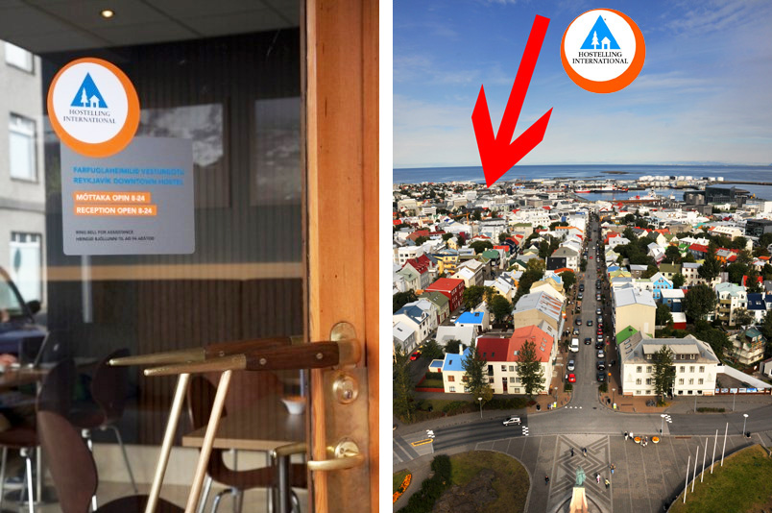

Slide 3
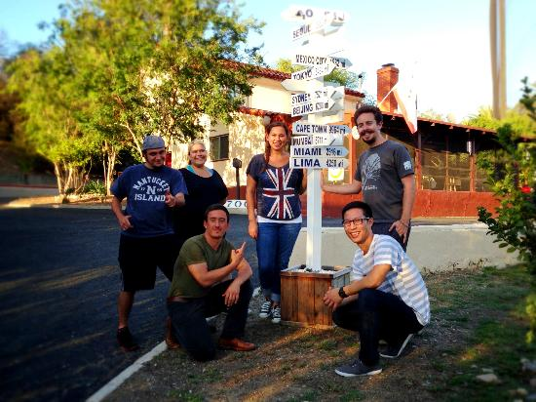

Slide 4
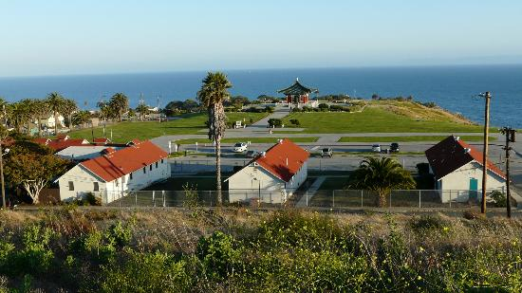
HI-Los Angeles, San Pedro

Slide 5
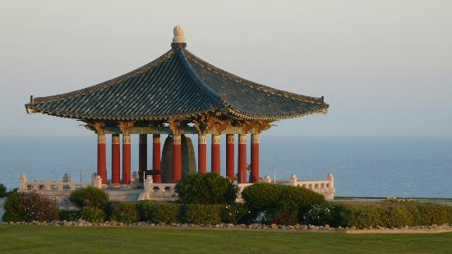
HI-Los Angeles, San Pedro

Slide 6
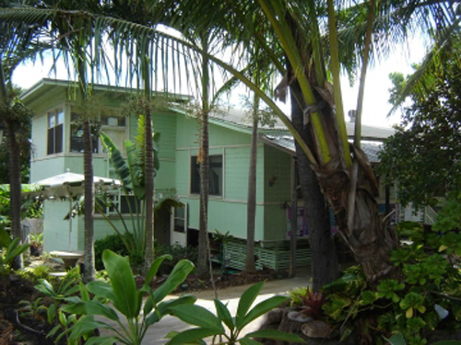
HI - Hawaii

Slide 8
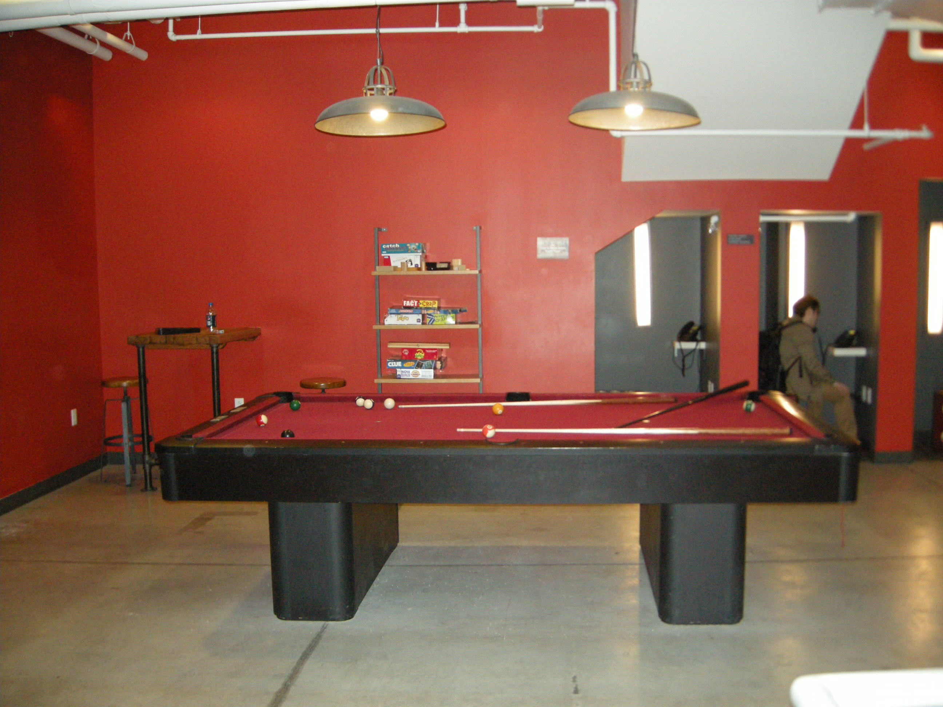

Slide 9
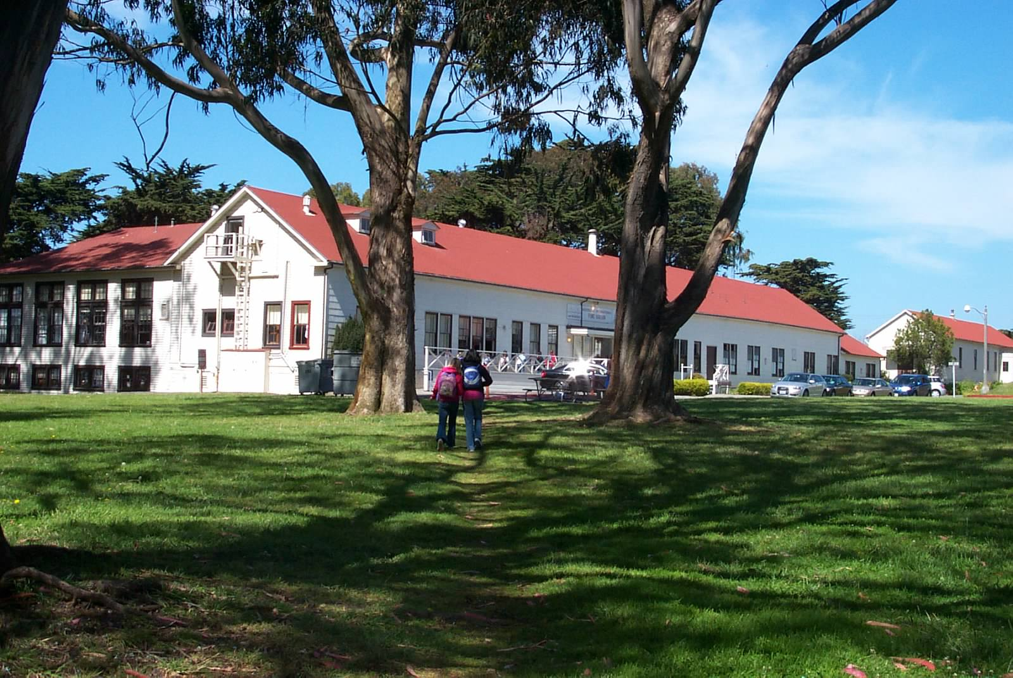
HI-USA, San Francisco Fisherman’s Wharf

Slide 10
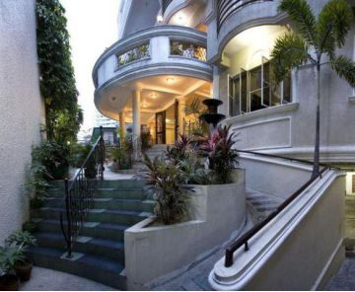
HI – Manila, Philippines

Slide 11
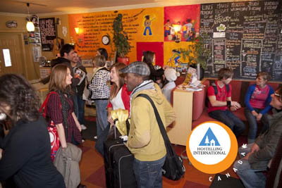

Slide 12
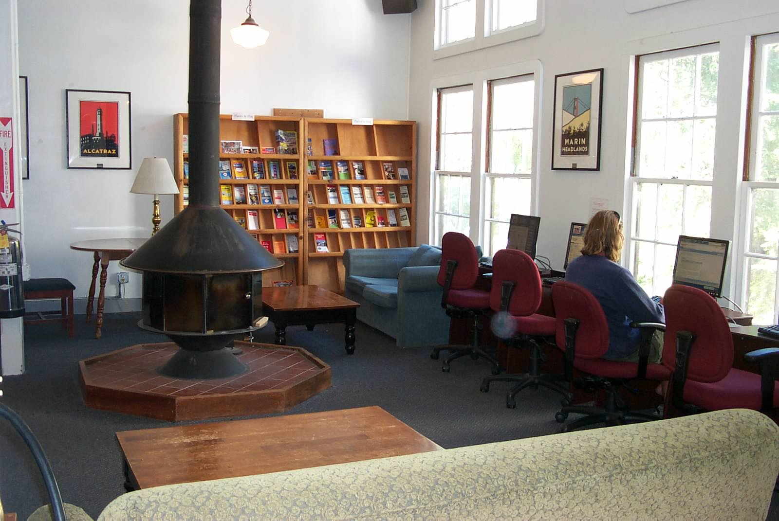

Slide 13
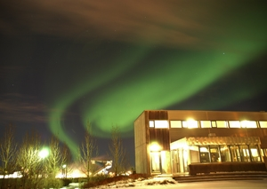
HI- Reykjavik, Iceland

Slide 14
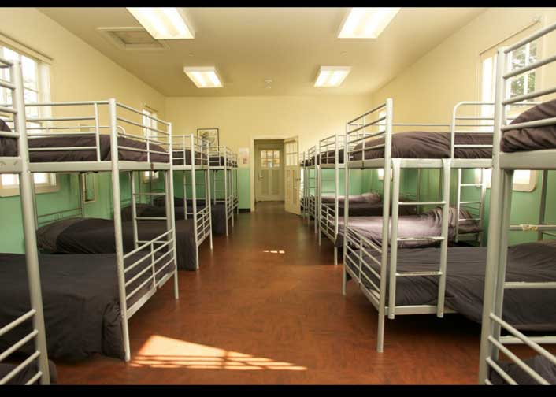

Slide 15
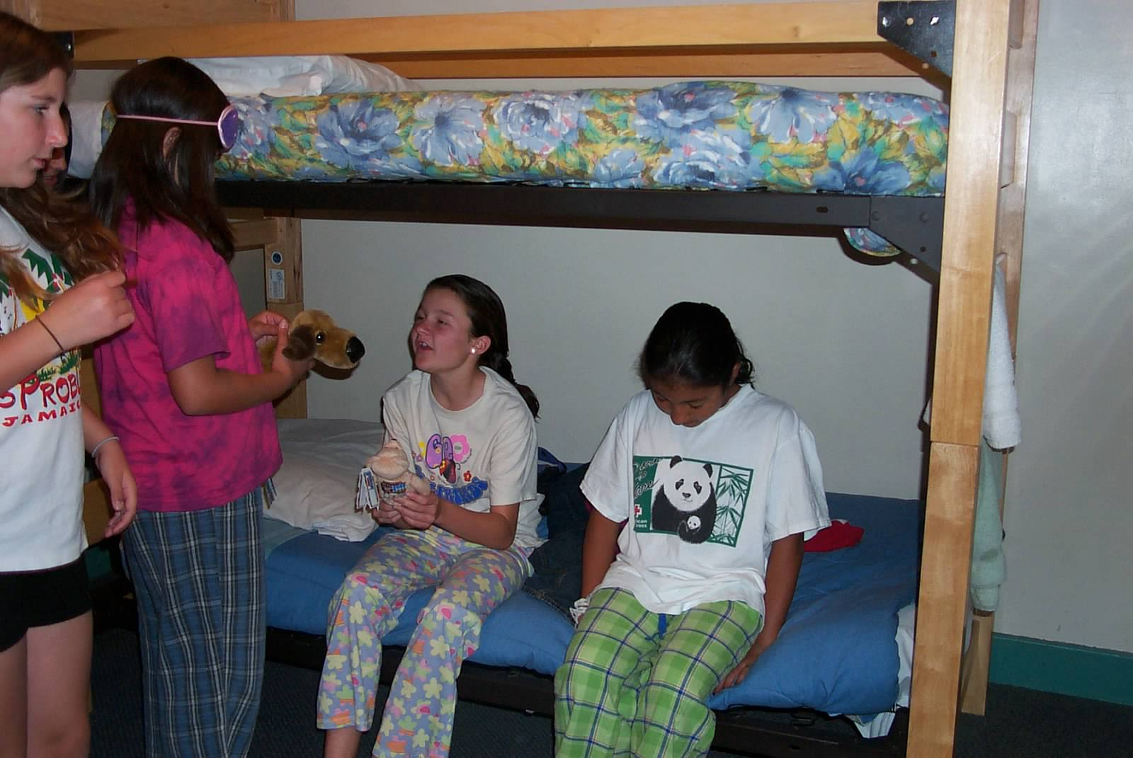
Girl Scouts at HI-USA, Fisherman’s Wharf

Slide 16
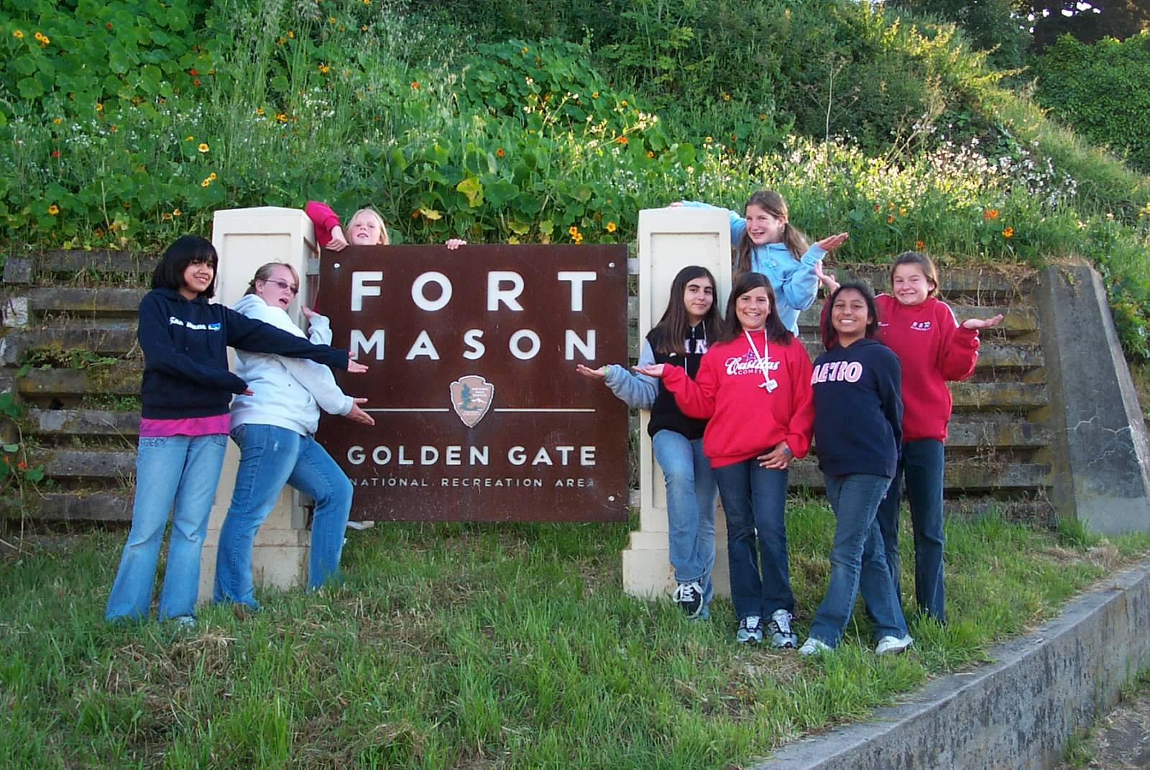

Slide 17
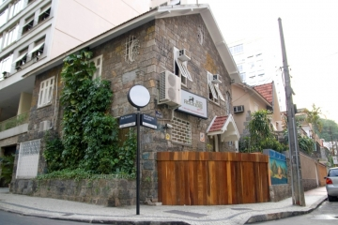
HI- Rio de Janeiro, Brazil

Slide 18
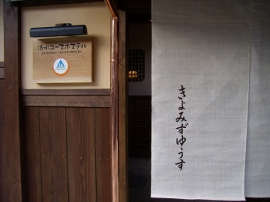
HI-Kyoto, Japan

Slide 19
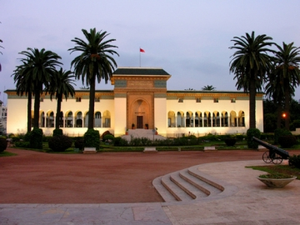
HI – Morocco, Casablanca

Slide 20
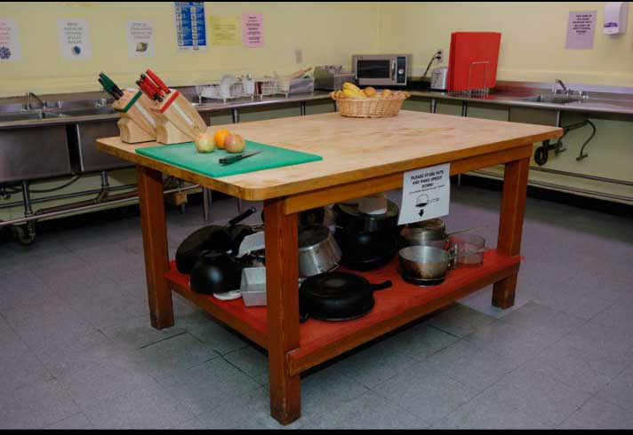

Slide 21
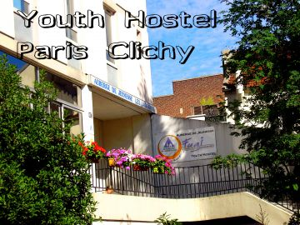

Slide 22
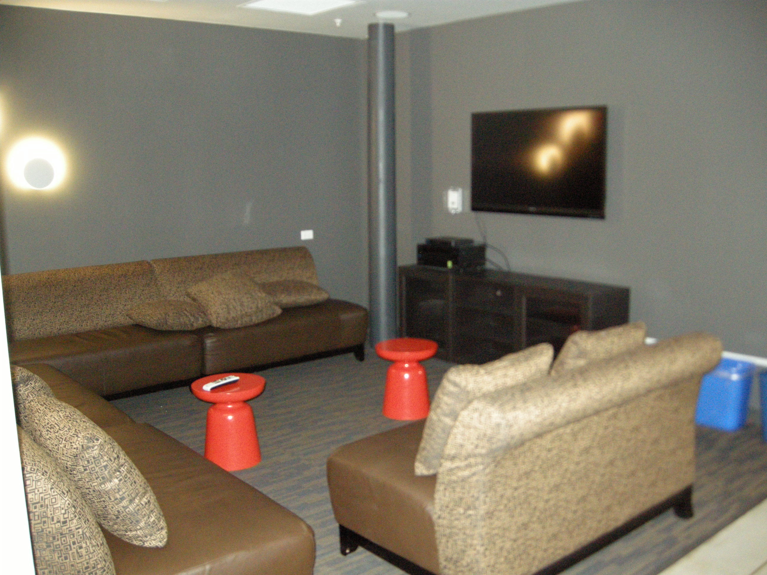

Slide 23
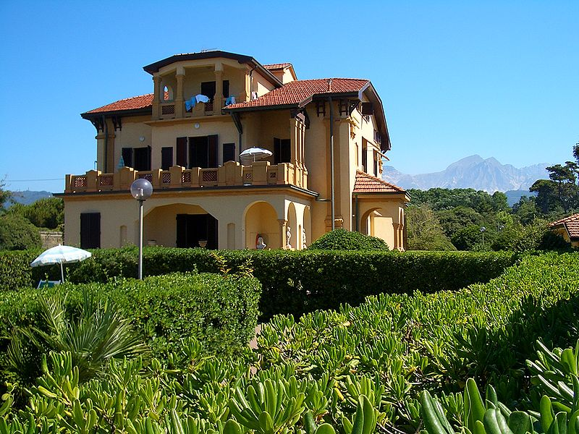
Marina di Carrara, Italy

Slide 24
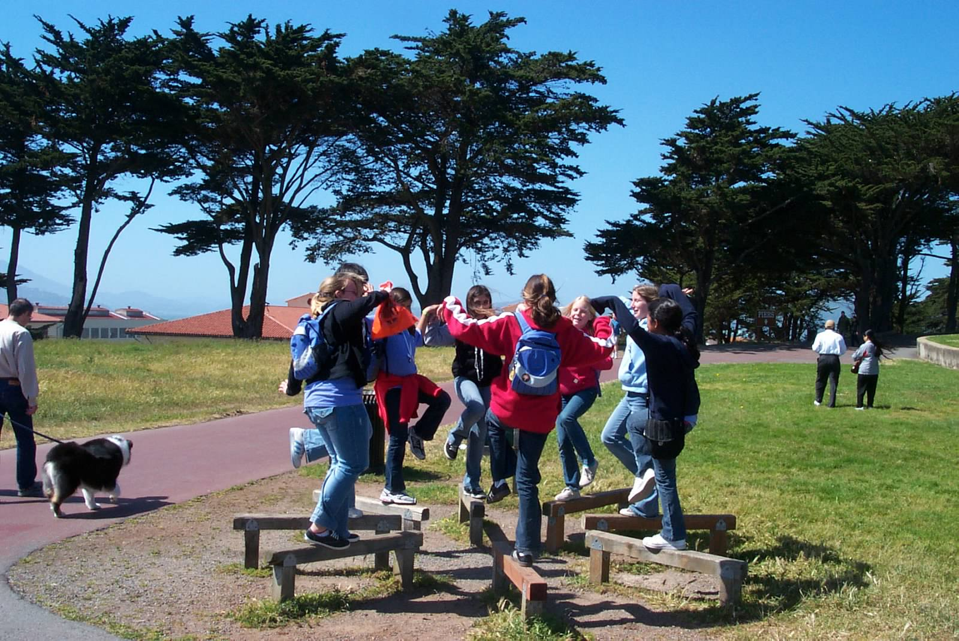

Slide 25
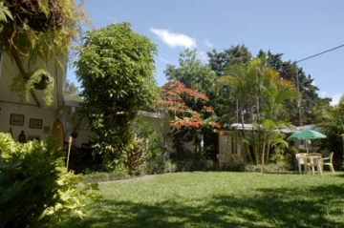
HI – San José, Costa Rica

Slide 26
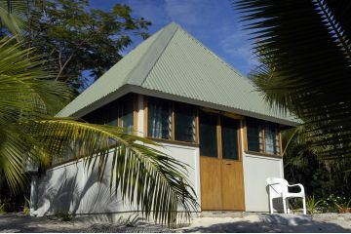
HI - Bouny Island Resort, Fiji

Slide 27
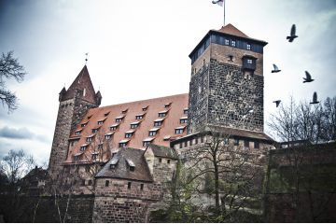
HI – Nürnberg, Germany

Slide 28
