Slide 1
Welcome!
Sunny Trails Service Unit Meeting
August 17, 2023
Thank you for joining us.
The meeting will start soon!

Slide 2
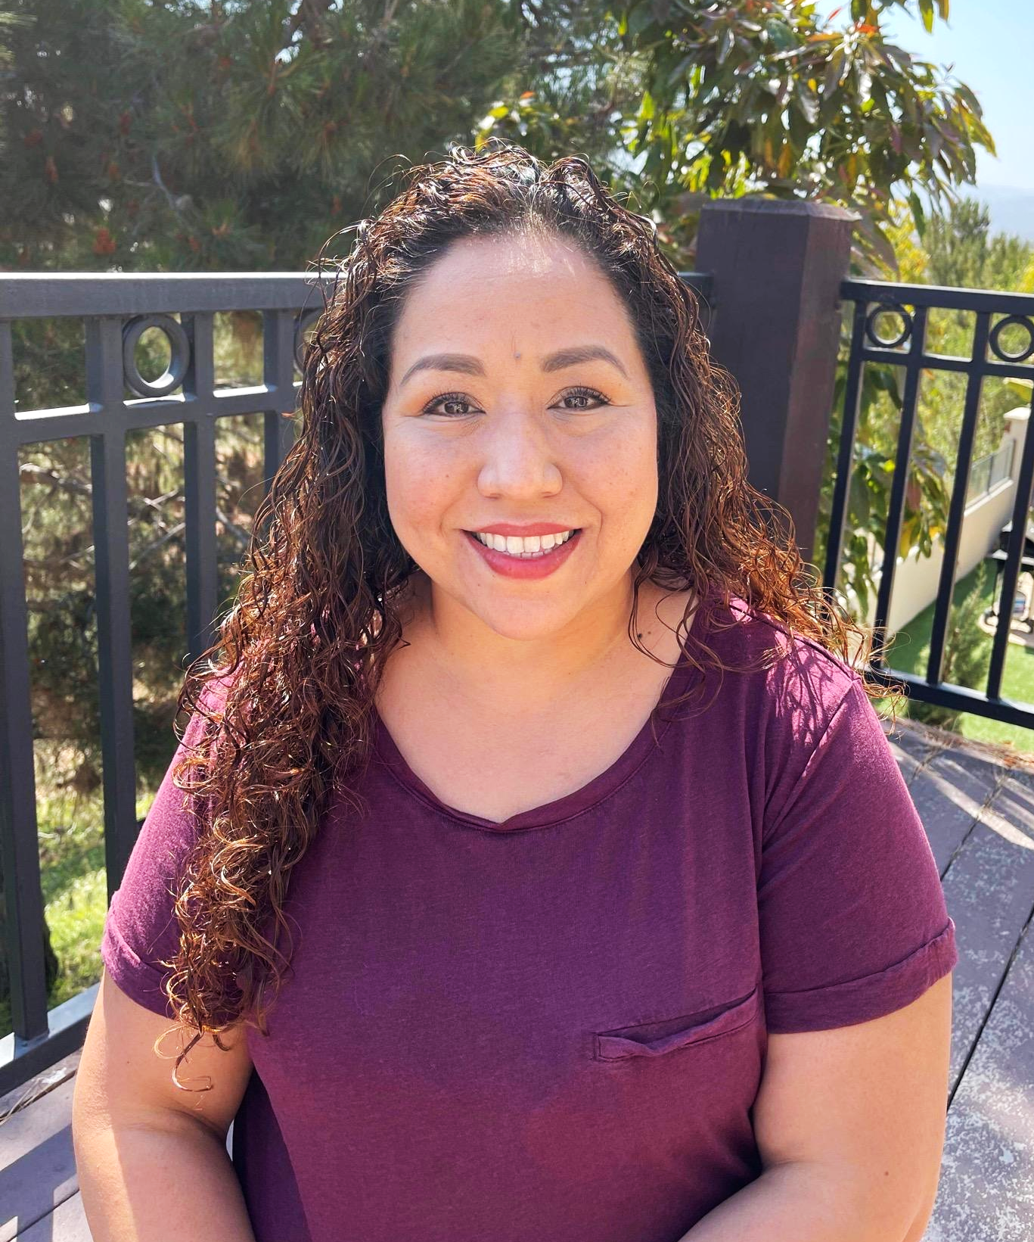
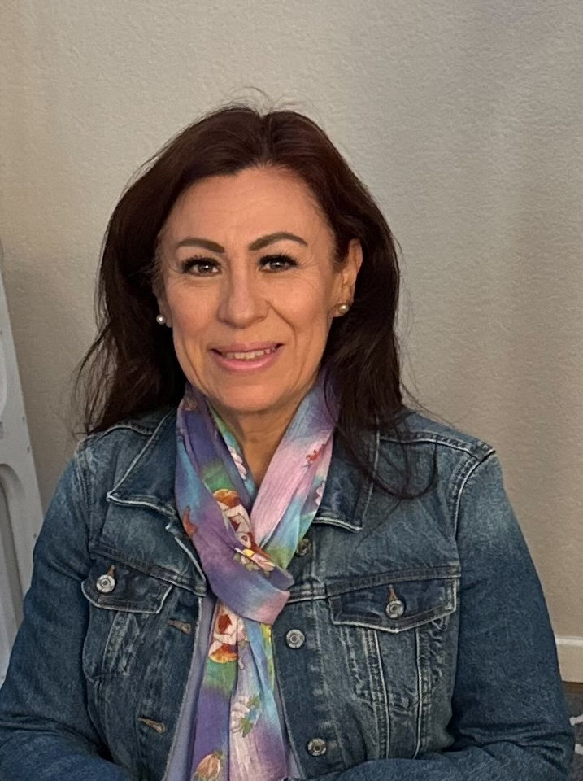
Sunny Trails Service Unit Managers
Your Meeting Host Tonight
Cindy Saenz DBJ@gssunnytrails.com | Julia Robles CSA@gssunnytrails.com

Slide 3
Meeting Agenda
Welcome/
Announcements
Flag Ceremony
Service Unit News
Meet the team
Financials
Rules game
Volunteer essentials
Volunteer conference
Leadership Camp
Daisy Encampment
Brownie Hike
Song Fest
Camp Surf
Council Events
Fall Sales
Live Scan

Slide 4
Flag Ceremony
Presented by Girl Scout Troop

Slide 5
Seeking Troops for SU Meeting Flag Ceremony
We are looking for troops to come help us start our Service Unit Meetings. If you troop is interested in participating please reach out to Susanna King at CSA@gssunnytrails.com or DBJ@gssunnytrails.com to sign up.
Each Girl Scout who participates in the flag ceremony will earn this Sunny Trails Ceremony patch.
Please note: our February SU meeting will be on Zoom.

Slide 6
Sunny Trails Service Unit Team
Service Unit Manager Daisy, Brownie, Junior Troops | Cindy Saenz | DBJ@gssunnytrails.com
Service Unit Manager Cadette, Senior, Ambassador Troops | Julia Robles | CSA@gssunnytrails.com
New Troops Support | Dolly Purificacion | newtroops@gssunnytrails.com
Treasurer and Troop Financials | Marilou Thomas | treasurer@gssunnytrails.com
Registrar/Recruitment | Amber Vissuet | registrar@gssunnytrails.com
Product Sales Committee Chair | Julia Robles | cookies@gssunnytrails.com
Product Sales Nuts | Karen Pickens | nuts@gssunnytrails.com
Recognitions | OPEN | recognitions@gssunnytrails.com
Activity Consultant | Susanna King | activityapproval@gssunnytrails.com
Encampment Director | Marisa Segoviano | encampment@gssunnytrails.com
Sunny Trails Website | Debbie Lechner | website@gssunnytrails.com
SHARE Coordinator | Selena Ellis-Vizcarra | share@gssunnytrails.com

Slide 7
Troop Finances
All troops must have an open troop account with Wells Fargo
Take Troop Treasurer training
Be registered, background checked, have had a parent meeting, need 2 signers, $50 to deposit
Keep all receipts
Yearly keep Financial Tracking Worksheet
Complete Annual Financial Report by June 1

Slide 8
Rules Game
Girl Code of Conduct
Create a troop agreement that everyone signs.
Guidelines for appropriate behavior
Appropriate language
Kapers
Consequences for not following the rules

Slide 9
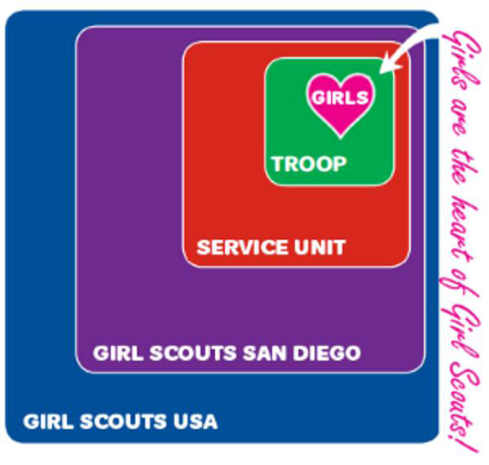
Volunteer Essentials
We are ~ Girl Scouts of the USA ~ Girl Scouts San Diego Council
~ Sunny Trails Service Unit #668, meet 3rd Thursday 7pm, Our boundaries are schools in Chula Vista and Bonita east of I-805, North of Main Street, and South of I-54. ~Your Girl Scout Troop ~You (the leader), your girls, the parent helpers

Slide 10
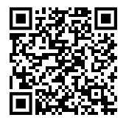
Volunteer Essentials
Volunteer Essentials
Volunteer Essentials is the Girl Scout volunteer handbook. Easily find what you need to get started on your Girl Scout journey and search for answers throughout the year.
Chapter 1: All About Girl Scouts Chapter 2: Engaging Girls and Families
Chapter 3: Troop Management
Chapter 4: Safety
Chapter 5: Troop Finances
Chapter 6: Product Program

Slide 11
Volunteer Essentials
Volunteer Essentials
Chapter 1: All About Girl Scouts
Promise/Law
Uniforms / Badges / Journeys
Special Girl Scout Days
Ceremonies
Leader Training - getting started and mandated reporter training - both online, First Aid, level training online, Outdoor Training, Highest Awards, Troop Tripping, Enrichment - Volunteer Conference/Outdoor Skills Weekend
Things to do with Girls (Meetings, Outdoors, Travel, Journeys/Badges, Highest Awards)

Slide 12
Volunteer Essentials
Volunteer Essentials
Chapter 2: Engaging Girls and Families
Girl Development by level
Tips for talking to and working with girls,
Parent Meeting
Getting help from parents,
Using Volunteer Toolkit - organize your year - badges, journey, special girl scout days, field trips to help with the badges or journey, service unit events

Slide 13
Volunteer Essentials
Volunteer Essentials
Chapter 3: Troop Management
Plan Troop Meetings using volunteer toolkit,
Activities & Outings,
Resolving Conflict

Slide 14
Volunteer Essentials
Volunteer Essentials
Chapter 4: Safety
Required forms,
Safety Activity Checkpoints,
Training & First Aid,
buddy system,
Vaccines,
Requesting Approval,
Insurance & Accidents
Overnights,
Creating a Safe Space,
Product Program Safety,

Slide 15
Volunteer Essentials
Volunteer Essentials
Chapter 5: Troop Finances
How troops get money
opening a troop account
Budgeting & tracking reporting finances (by June 1)
Financial assistance

Slide 16
Volunteer Essentials
Volunteer Essentials
Chapter 6: Product Program
About Cookies & Fall Program,
Skills Girls Learn,
Where proceeds go,
Training,
Volunteer’s Role

Slide 17
Volunteer Essentials
Volunteer Essentials
Chapter 6: Product Program
About Cookies & Fall Program,
Skills Girls Learn,
Where proceeds go,
Training,
Volunteer’s Role
QUESTIONS?

Slide 18
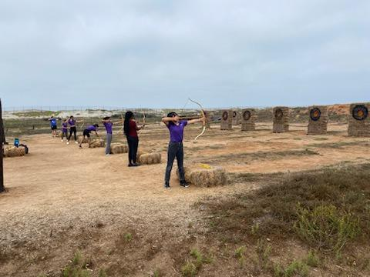
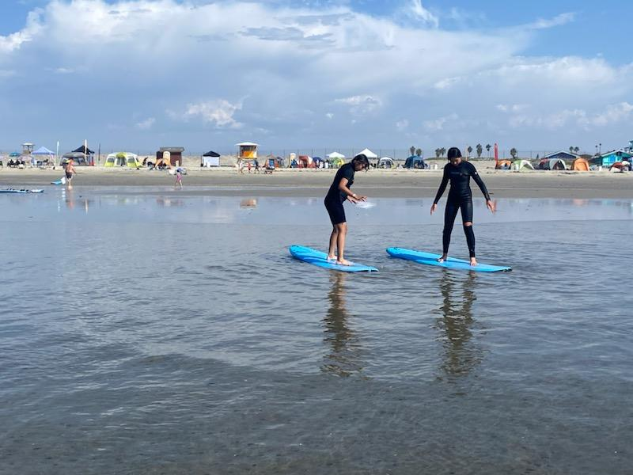
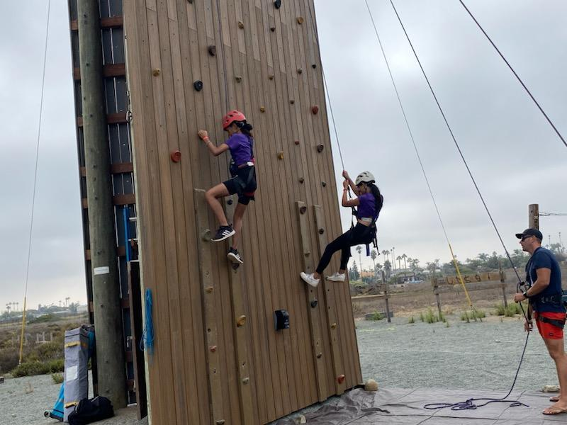
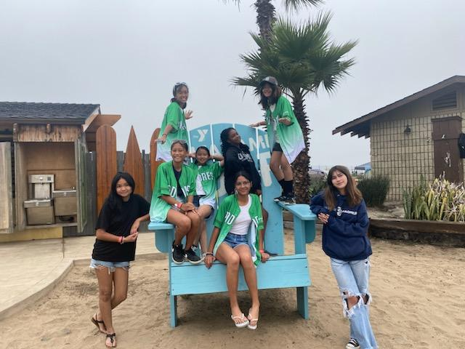
Camp Surf 2022

Slide 19
Saturday, Aug. 26 8 a.m.-3:45 p.m. Balboa Campus Registration closes Sunday, Aug. 20
All attendees will enjoy inspiring sessions, a catered lunch, time with community partners, networking with Girl Scout friends old and new, previewing the 2024 product program, and snagging special deals from the Girl Scout store.
Register now @ sdgirlscouts.org

Slide 25
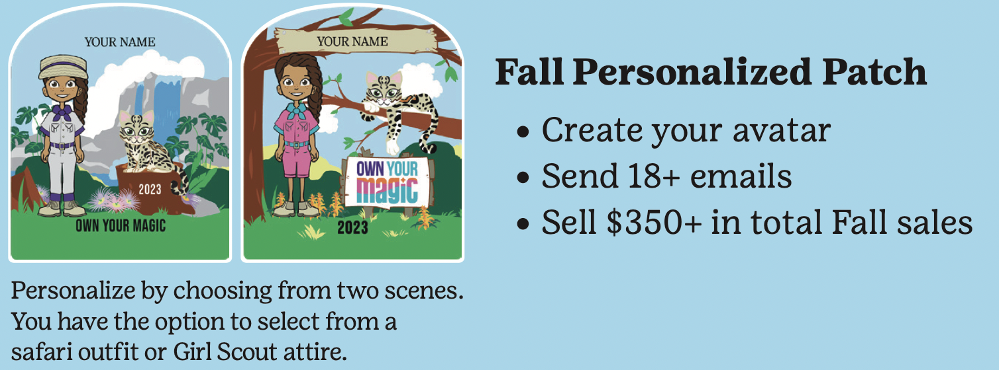
Fall Sales
Important dates:
Sept-Oct: Online training is available
Mon, Oct. 2: Fall sales begin. Girls have access to M2
Sun, Oct. 22 @ 11:59 pm: Family deadline to enter in–person orders into M2
Wed, Oct. 25: Last day for customers to order online
Sat, Nov. 11: Delivery day
Fri, Dec. 1: Troop funds due in troop bank account by end of business day
Feb 2024: Rewards distributed

Slide 26
LiveScan - Don’t miss this opportunity!
Thank you to all have gone to get their LiveScan done!
If you need to get your LiveScan done, please send an email to customercare@sdgirlscouts.org with-
Subject: Fingerprinting- Sunny Trails
Message: I would like to sign up for fingerprinting.
Troop #:
Role:
and of course 2023/2024 Membership

Slide 27
Thank You for Joining Us!
Sunny Trails Service Unit Team
Service Unit Manager Daisy, Brownie, Junior Troops | Cindy Saenz | DBJ@gssunnytrails.com
Service Unit Manager Cadette, Senior, Ambassador Troops | Julia Robles | CSA@gssunnytrails.com
New Troops Support | Dolly Purificacion | newtroops@gssunnytrails.com
Treasurer and Troop Financials | Marilou Thomas | treasurer@gssunnytrails.com
Registrar/Recruitment | Amber Vissuet | registrar@gssunnytrails.com
Product Sales Committee Chair | Julia Robles | cookies@gssunnytrails.com
Product Sales Nuts | Karen Pickens | nuts@gssunnytrails.com
Recognitions | OPEN | recognitions@gssunnytrails.com
Activity Consultant | Susanna King | activityapproval@gssunnytrails.com
Encampment Director | Marisa Segoviano | encampment@gssunnytrails.com
Sunny Trails Website | Debbie Lechner | website@gssunnytrails.com
SHARE Coordinator | Selena Ellis-Vizcarra | share@gssunnytrails.com

Slide 28
Please join us at our next meeting on Thursday, September 14th. Our next meeting will be a in-person Meeting Starting at 7 p.m.
Sunny Trails

