Slide 1
Welcome!
Sunny Trails Service Unit Meeting
September 22, 2023
Thank you for joining us.
The meeting will start soon!

Slide 2
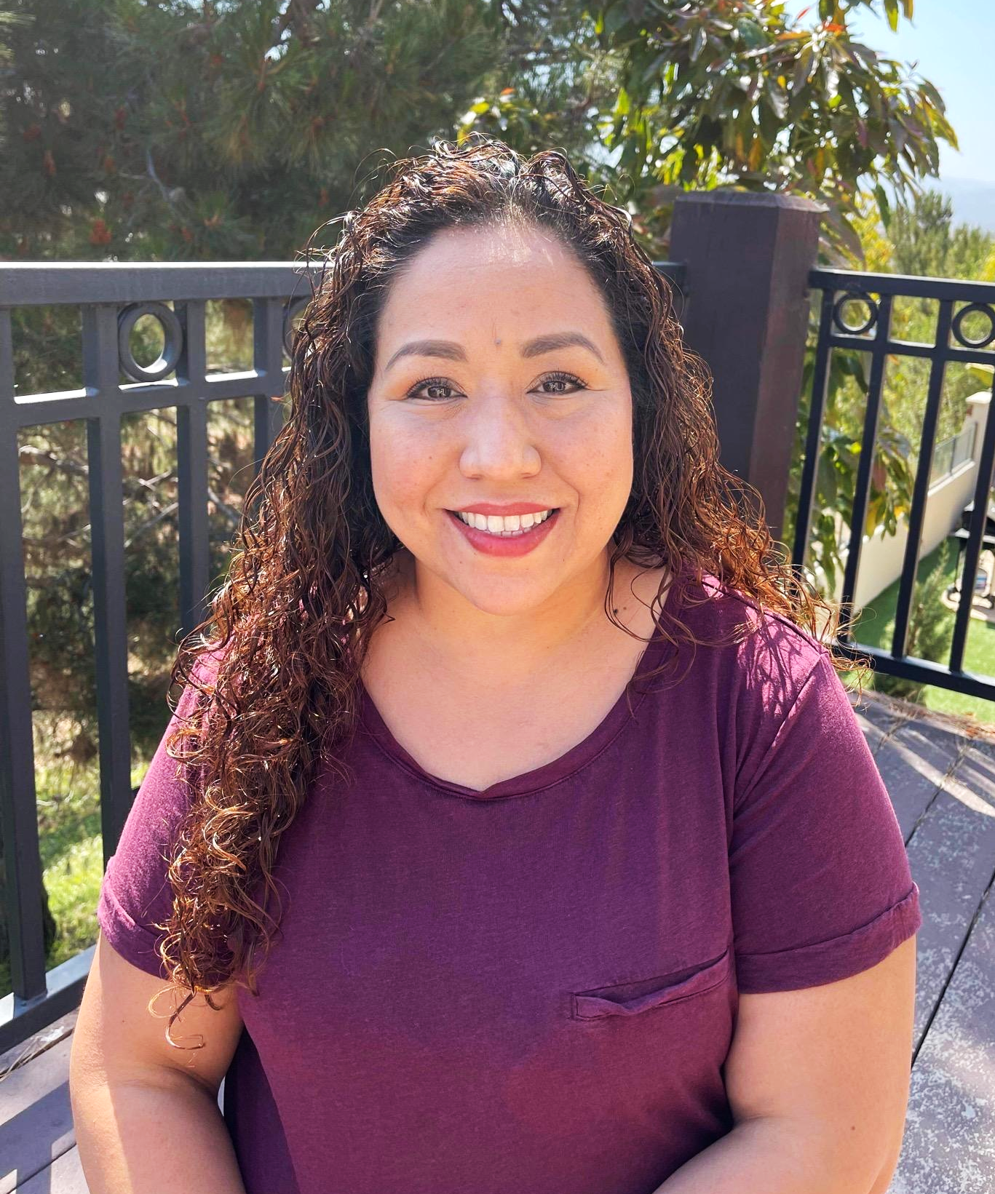
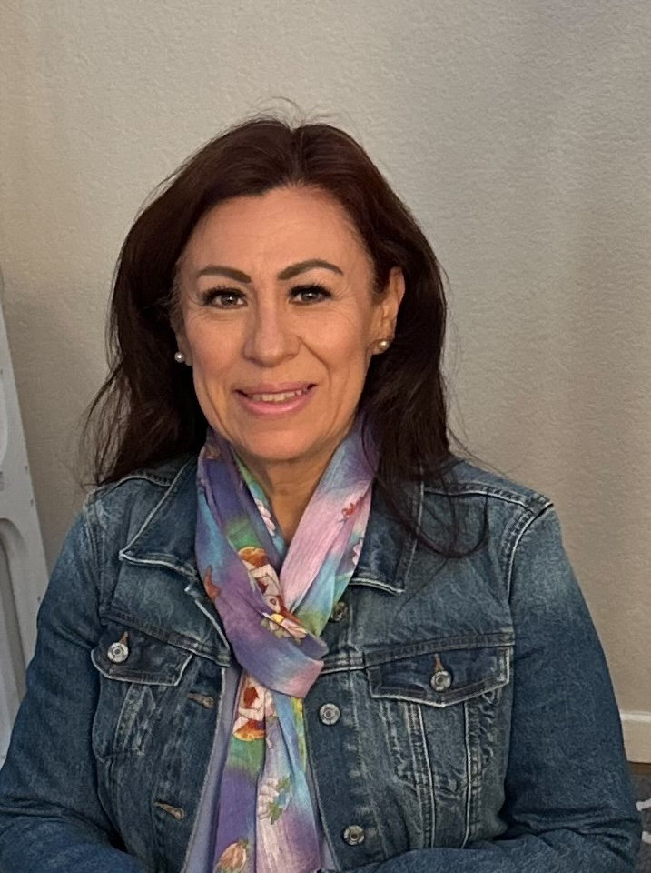
Sunny Trails Service Unit Managers
Your Meeting Host Tonight
Cindy Saenz DBJ@gssunnytrails.com | Julia Robles CSA@gssunnytrails.com

Slide 3
AGENDA
Welcome / Announcements
Flag Ceremony / Promise / Law
Service Unit News & Events
Fall Sales
Think Like a Scientist
Princess Tea Party
Princess Holiday Party
Troop #6165 Silver Project
Share - Ice blocking
Starlight Parade
Wreaths Across America
December Brownie Encampment
Cookie Kick Off
Recruitment for SU
Leadership Camp 2
Council Events
Live Scan
Destinations Expo 2023
Mini Training - Money Earning Project Proposals

Slide 4
Flag Ceremony
Girl Scout Promise/Law
Presented by Girl Scout Troop #
On my honor, I will try: To serve God* and my country, To help people at all times, And to live by the Girl Scout Law.
I will do my best to be honest and fair, friendly and helpful, considerate and caring, courageous and strong, and responsible for what I say and do, and to respect myself and others, respect authority, use resources wisely, make the world a better place, and be a sister to every Girl Scout.

Slide 5
Seeking Troops for SU Meeting Flag Ceremony
We are looking for troops to come help us start our Service Unit Meetings. If you troop is interested in participating please reach out to Susanna King at CSA@gssunnytrails.com or DBJ@gssunnytrails.com to sign up.
Each Girl Scout who participates in the flag ceremony will earn this Sunny Trails Ceremony patch.

Slide 6
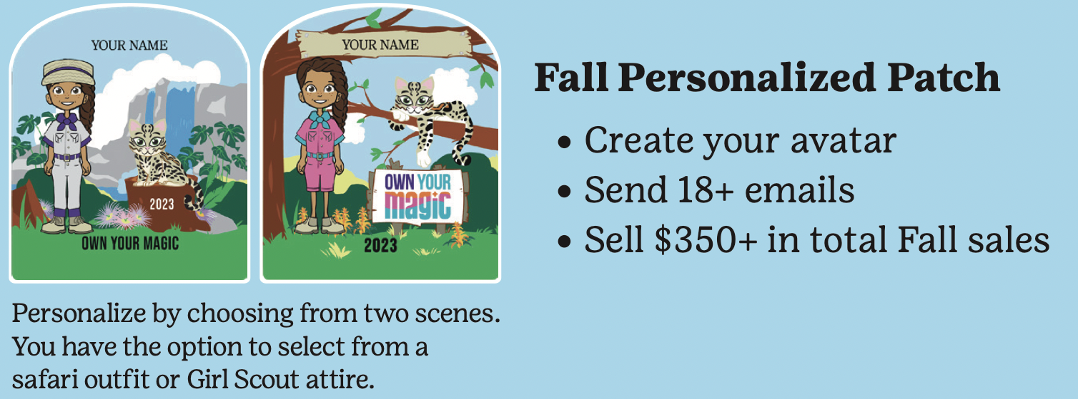
Fall Sales
Important dates:
Sept-Oct: Online training is available
Mon, Oct. 2: Fall sales begin. Girls have access to M2
Sun, Oct. 22 @ 11:59 pm: Family deadline to enter in–person orders into M2
Wed, Oct. 25: Last day for customers to order online
Sat, Nov. 11: Delivery day Volunteers needed
Fri, Dec. 1: Troop funds due in troop bank account by end of business day
Feb 2024: Rewards distributed

Slide 11
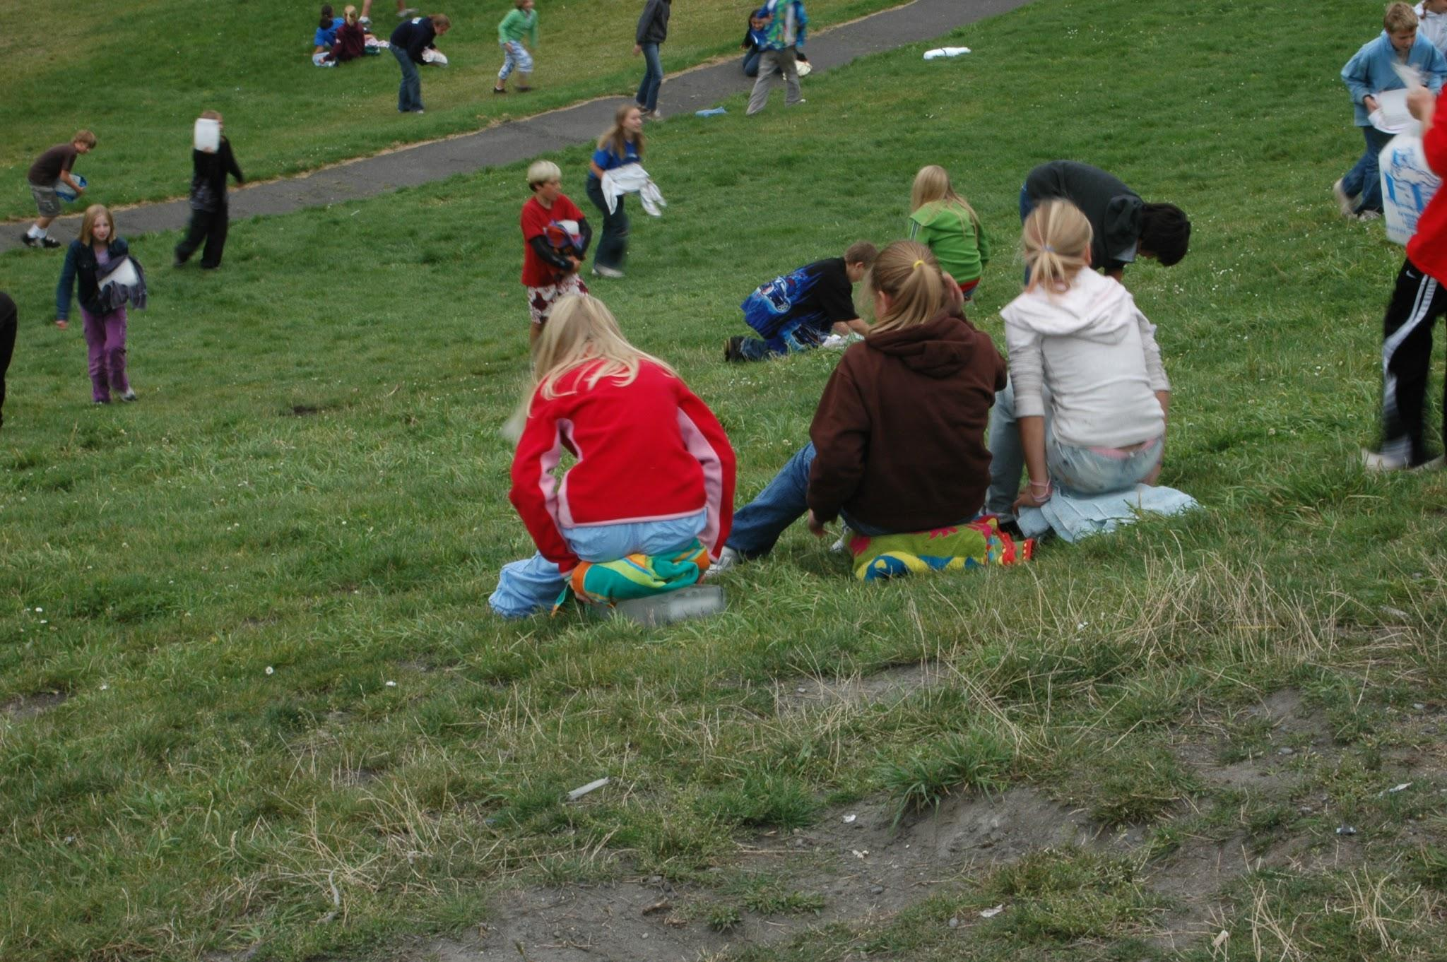
SHARE CAMPAIGN
Ice Blocking for Share December 2,2023 Santa Cora Park 12-3pm

Slide 12
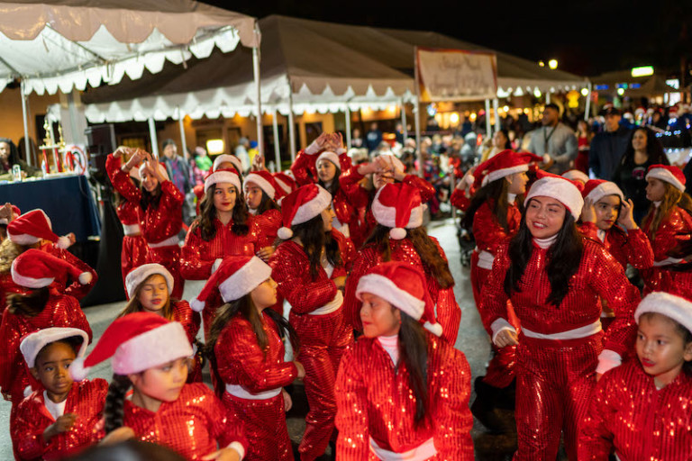
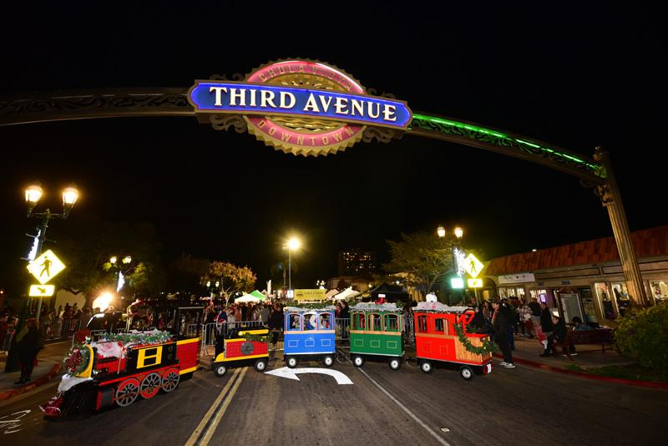
Starlight Parade Sunday December 3, 2023 3:00-8:00pm
Application has been submitted
Sign up if interested in participating
Ideas for costumes
Maximum 100 girls from both SU

Slide 13
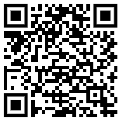
Please join us for the 4th annual Wreaths Across America Ceremony and laying of the wreaths. All are welcome to attend. This is a great way to show support to our
veterans who have passed on. The mission for WWA is Remember, Honor and Teach. For more information about the event please visit or to find out how to sponsor a wreath:
https://www.wreathsacrossamerica.org/
or reach out to Julia Robles at csa@gssunnytrails.com
Date: Saturday, December 16, 2023
Time: 9:00 a.m.
Location: Glen Abbey Memorial Park &amp; Mortuary
3838 Bonita Rd, Bonita, CA 91902

Slide 18
LiveScan - Don’t miss this opportunity!
Thank you to all have gone to get their LiveScan done!
If you need to get your LiveScan done, please send an email to customercare@sdgirlscouts.org with-
Subject: Fingerprinting- Sunny Trails
Message: I would like to sign up for fingerprinting.
Troop #:
Role:
and of course 2023/2024 Membership
Deadline September 30th

Slide 19
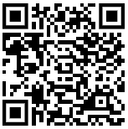
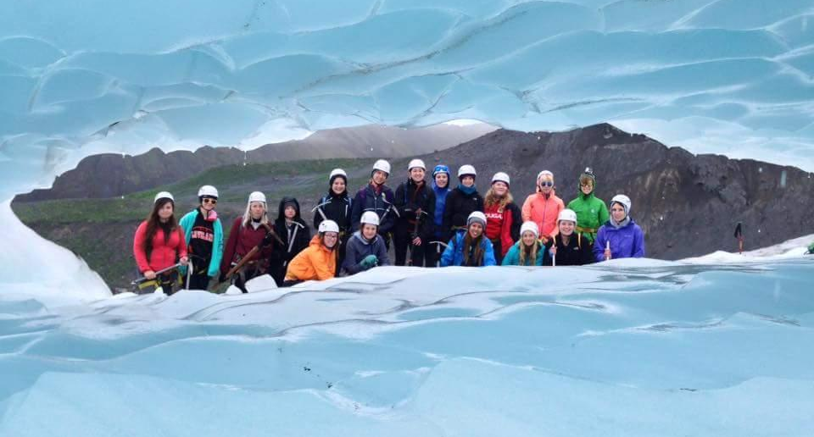
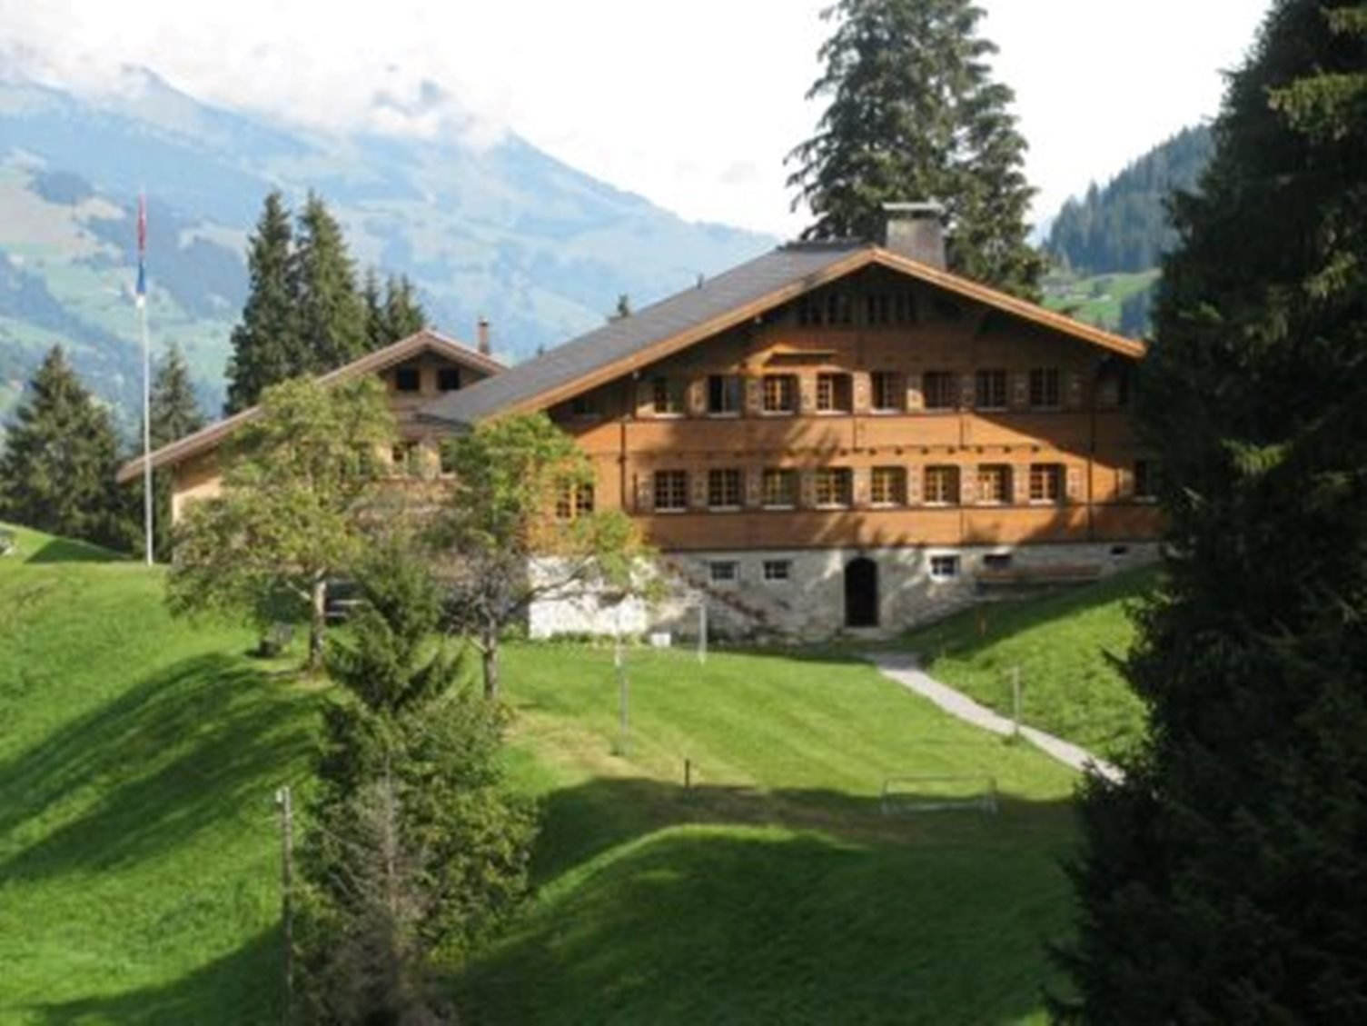
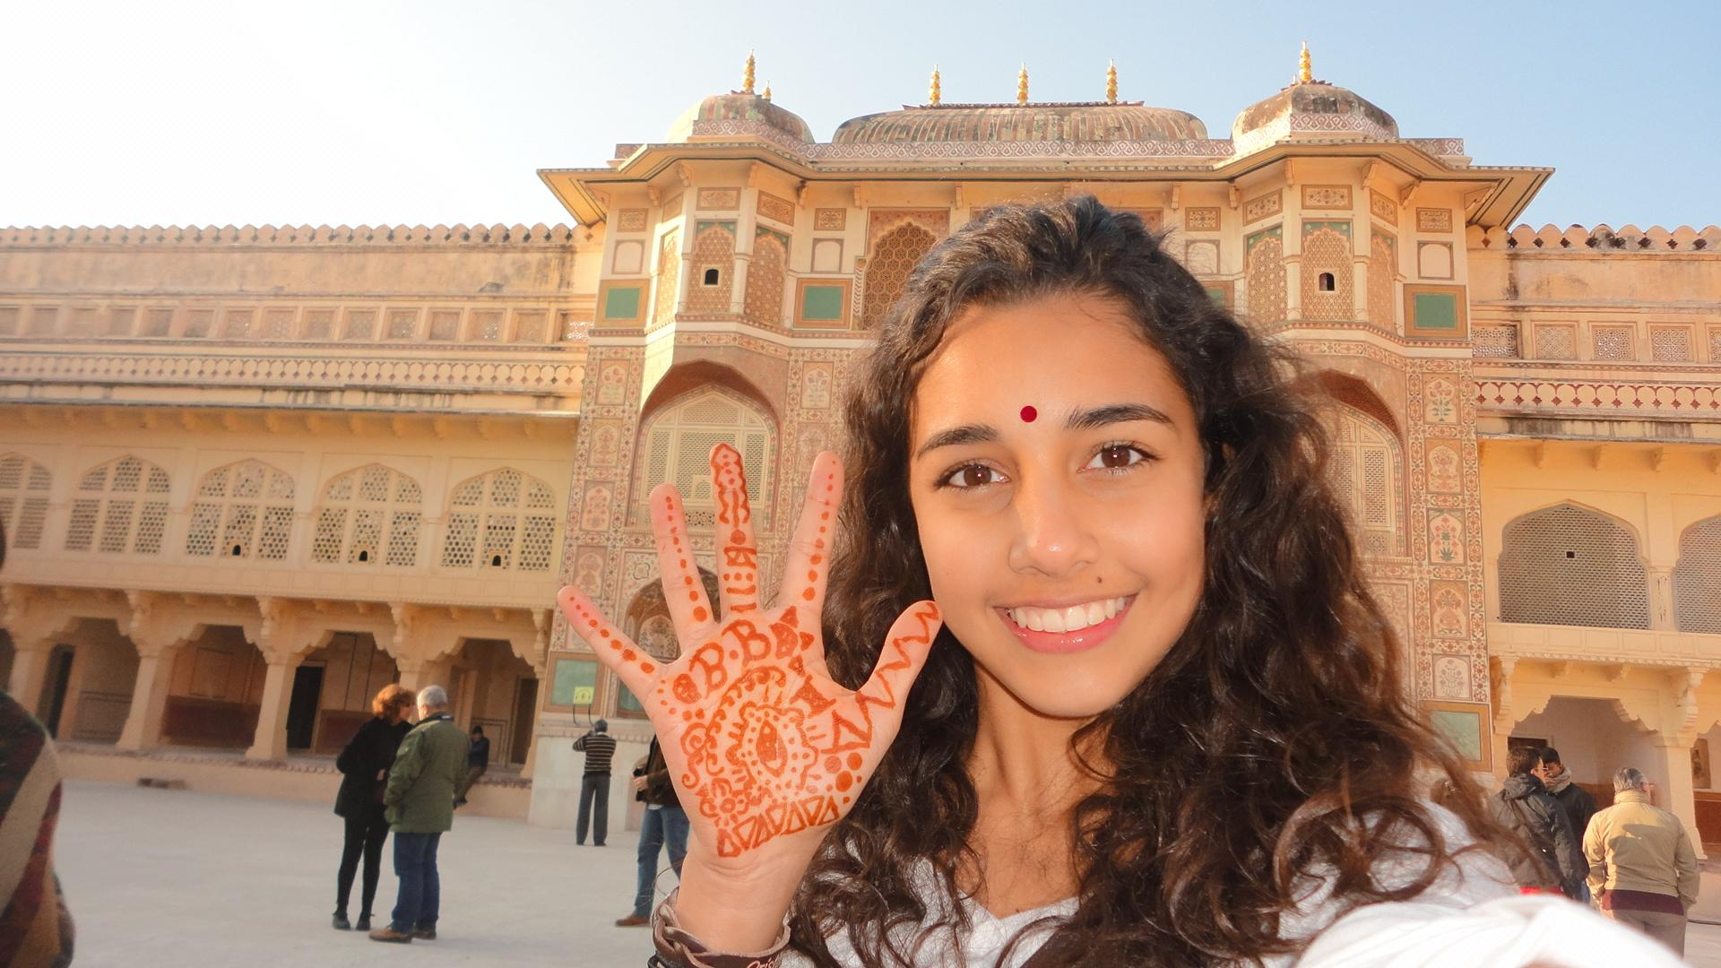
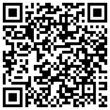
Destinations Expo 2023
Destinations are Individual Girl Scout Travel Opportunities!
Wednesday, September 27, 6:30-8, Virtual, Free!
Event Registration
About Destinations

Slide 20
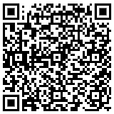
Money Earning Project Proposals
Money Earned Belongs to the Troop - no matter who participates
Project is age appropriate, good Girl Scout value and includes girl planning,
Can’t compete with cookie program or fall sale,
Scheduled for single date
Participate in both cookie program and fall sale in the same membership year
Financials up to date & checking account with Wells Fargo
Purpose for fund raising is clearly defined and discussed with girls and parents
Profit estimate from the project should be less than $500.
My Tip - charge less / get more engagement! / lower expectations fewer materials / less expenses / more profit
(example: $10 x 8 girls = $80 $3 x 60 girls = $180)
Money Earning Project Application

Slide 21
Money Earning Project Proposals
Appropriate Projects Inappropriate Projects
# of money-earning projects by GS level not including recycling
Run events like Thinking Day, Bridging or Global Days, Badge & Journey Workshops, Lead a hike, a Camp or Trip, Walking Tours, Songfest, have Garage Sale, Dances, do Luminarias, Photo Booth, Face Painting, Tea, Breakfast, Dinner, Play or Concert, write a troop Cookbook, do gift-wrapping.
Games of chance like raffles, contests or bingo. Product demonstrations like Avon, Mary Kay, Pampered Chef, etc. Sales for another company like See’s, Pizza Hut, Rubios, catalog sales, selling gift wrap. May not collect to benefit another non-profit or ask for direct donations.
Daisies (Kinder) 0 Daisies (1st grade) 1
Brownies 1
Juniors 2
Cadettes 3* Seniors
Ambassadors
*Additional projects for older girls may be approved by the council finance support specialist. Email troopbanking@sdgirlscouts.org
Money Earning Project Application

Slide 22
Money Earning Project Proposals
Submit: Application, Flyer (check branding) & Budget Worksheet
4 weeks ahead of when you want to start promoting the project.
Follow the Money-Earning Project Checklist to Ensure Project:
When project is finished: Evaluate with troop / submit Money Earning Final Report & Budget Worksheet with Financials (in May)
Is Voluntary
Includes girl planning
Is clearly defined & communicated to parents
Is consistent with Girl Scout Leadership Experience
Solely funds Girl Scout activities
Parents have given written permission
Additional Girl Scout insurance has been purchased if necessary
Event Approval Checklist and Event Budget Worksheet have been completed and reviewed by your service unit.
Money Earning Project Application

Slide 23
Thank You for Joining Us!
Sunny Trails Service Unit Team
Service Unit Manager Daisy, Brownie, Junior Troops | Cindy Saenz | DBJ@gssunnytrails.com
Service Unit Manager Cadette, Senior, Ambassador Troops | Julia Robles | CSA@gssunnytrails.com
New Troops Support | Dolly Purificacion | newtroops@gssunnytrails.com
Treasurer and Troop Financials | Marilou Thomas | treasurer@gssunnytrails.com
Registrar/Recruitment | Amber Vissuet | registrar@gssunnytrails.com
Product Sales Committee Chair | Julia Robles | cookies@gssunnytrails.com
Product Sales Nuts | Karen Pickens | nuts@gssunnytrails.com
Recognitions | OPEN | recognitions@gssunnytrails.com
Activity Consultant | Susanna King | activityapproval@gssunnytrails.com
Encampment Director | Marisa Segoviano | encampment@gssunnytrails.com
Sunny Trails Website | Debbie Lechner | website@gssunnytrails.com
SHARE Coordinator | Selena Ellis-Vizcarra | share@gssunnytrails.com

Slide 24
Please join us at our next meeting on Thursday, October 19th. Our next meeting will be a in-person Meeting Starting at 7 p.m.
Sunny Trails

