Slide 1
Welcome!
Sunny Trails Service Unit Meeting
November 16, 2023
Thank you for joining us.
The meeting will start soon!

Slide 2
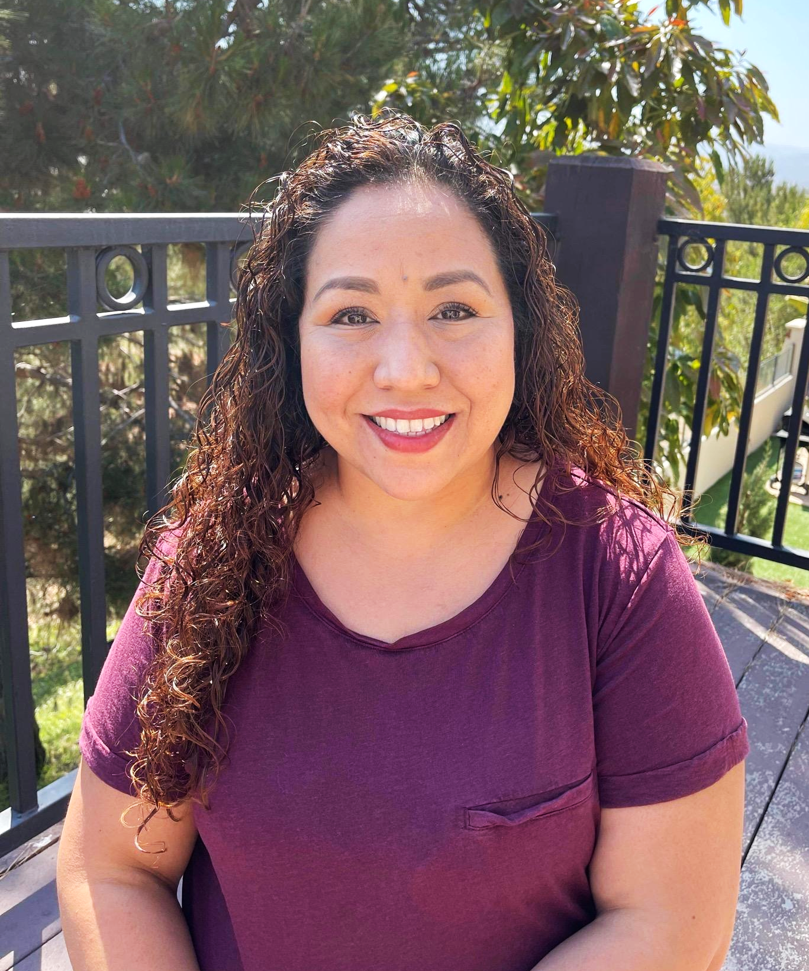
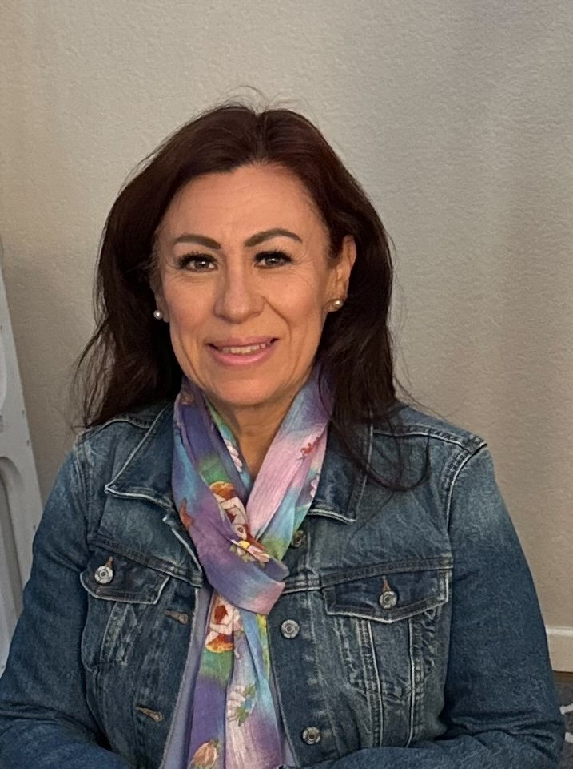
Sunny Trails Service Unit Managers
Your Meeting Host Tonight
Cindy Saenz DBJ@gssunnytrails.com | Julia Robles CSA@gssunnytrails.com

Slide 3
Meeting Agenda
Welcome/
Announcements
Flag Ceremony
Service Unit News
Troop 6344 Silver Award
Fall Sales
Share
Starlight Parade
Cookies
Wreaths Across America
Council Events
Live Scan
Cookie Kick Off
Recruitment for SU
Leadership Camp 2

Slide 4
Flag Ceremony
Girl Scout Promise/Law
Presented by Girl Scout Troop #
On my honor, I will try: To serve God* and my country, To help people at all times, And to live by the Girl Scout Law.
I will do my best to be honest and fair, friendly and helpful, considerate and caring, courageous and strong, and responsible for what I say and do, and to respect myself and others, respect authority, use resources wisely, make the world a better place, and be a sister to every Girl Scout.

Slide 5
Seeking Troops for SU Meeting Flag Ceremony
We are looking for troops to come help us start our Service Unit Meetings. If you troop is interested in participating please reach out to Susanna King at CSA@gssunnytrails.com or DBJ@gssunnytrails.com to sign up.
Each Girl Scout who participates in the flag ceremony will earn this Sunny Trails Ceremony patch.

Slide 6
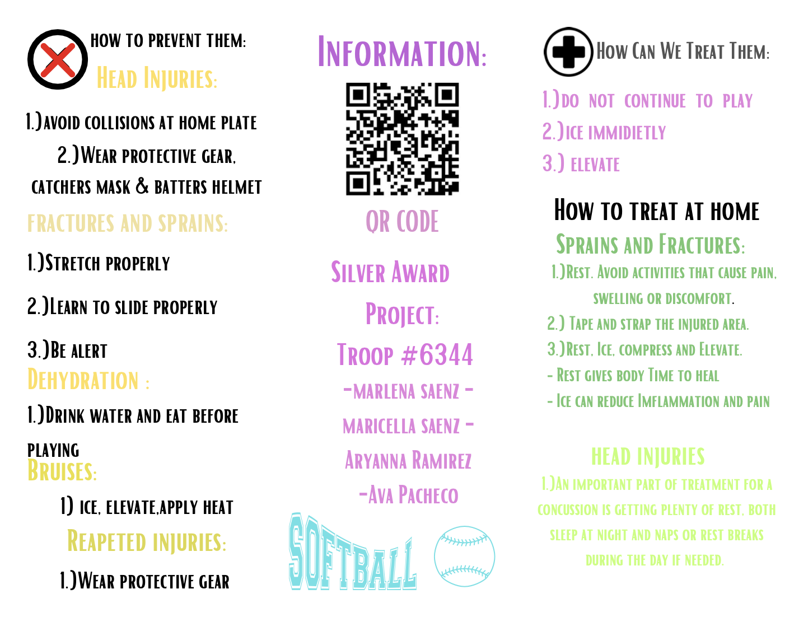
Troop 6344 Silver Award

Slide 7
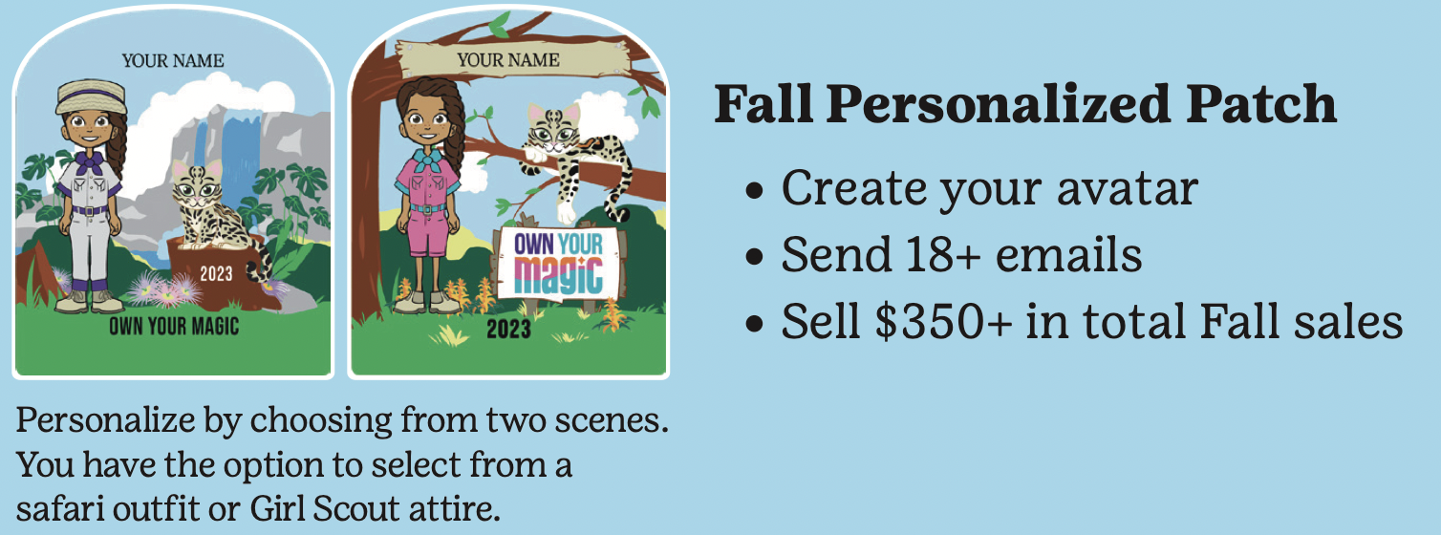
Fall Sales
Important dates:
Wed, Nov. 15: Extra nuts available at council
Fri, Dec. 1: Troop funds due in troop bank account by end of business day
Feb 2024: Rewards distributed

Slide 8
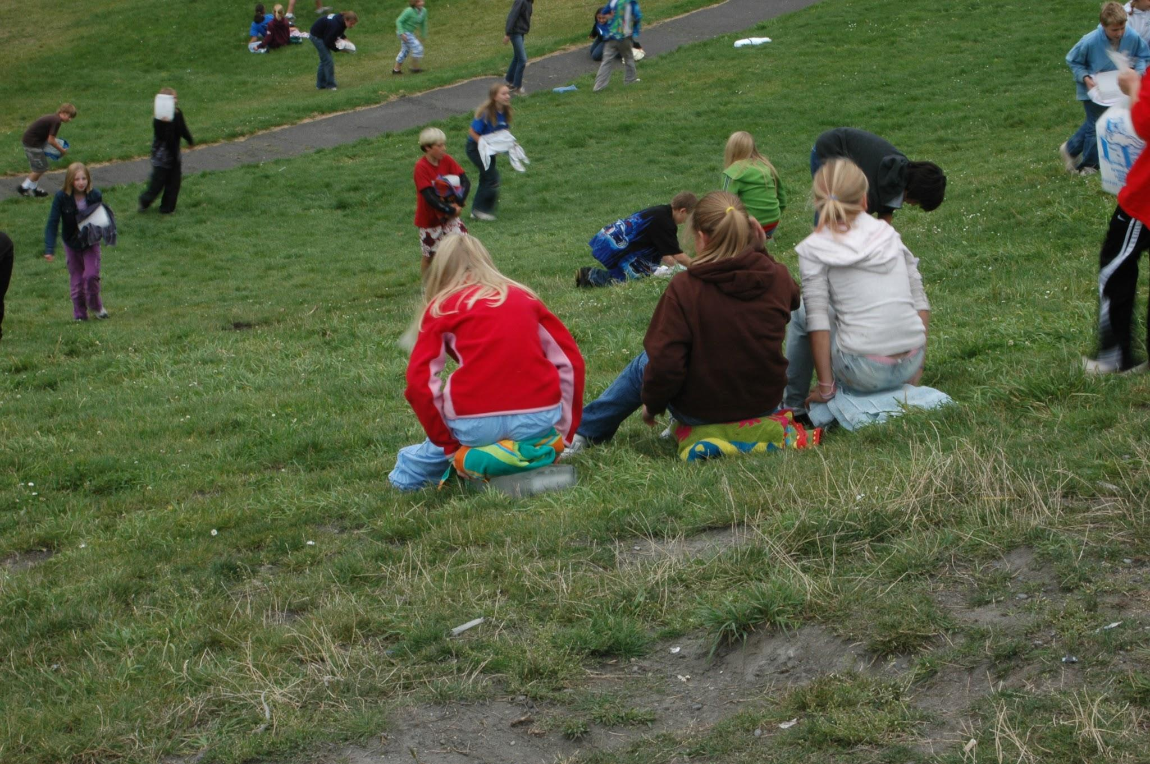
Share Campaign Ice Blocking
Saturday, Dec 2nd. 2023 12-3 pm
Santa Cora Park $15 PP

Slide 9
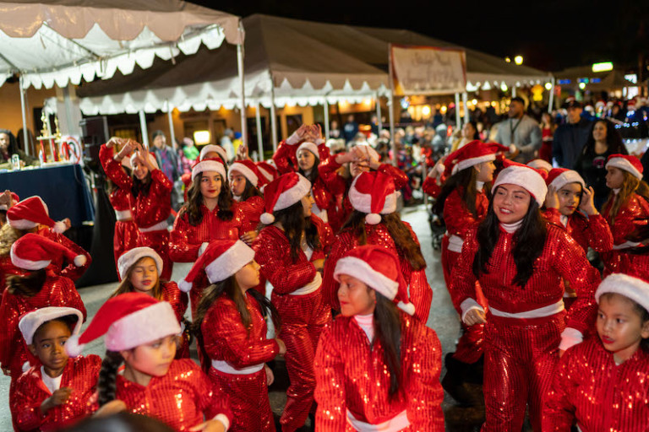
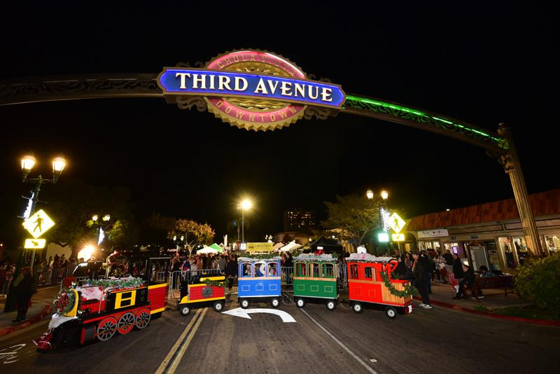
Starlight Parade Sunday December 3, 2023 3:00-8:00pm
Parade starts at 6:00pm
Check in at 5:00pm latest we will be in group 2
Elf hats or Elf headbands
Maximum 100 girls

Slide 10
Chula Vista Starlight Parade 2023
Parade Information PLEASE NOTE THIS YEAR, THE PARADE WILL START AT 6:00PM!
Thank you for joining us for the Chula Vista Starlight Parade 2023! Please take a few minutes to read over the following information to help minimize day-of confusion. If for any reason you require assistance on the day of the parade, please contact Jacob Hendersen at 619-905-1106 or Laurel McFarlane at 619-392-0548.
Check In:
· Check in will START at 3:00 PM on Sunday, December 3, 2023.
· Check-in will be in one of the 3 parade staging areas
o A GROUP H St. between 4th Ave. and 3rd Ave.
o B GROUP - H St. between 3rd Ave. and 2nd Ave.
o C GROUP- 3rd Ave. between I St. and H St.
· Check-in tables will be under canopies with signs that say “Check-in”
· You will receive your parade line up number upon check-in.
· Staff will be available to assist you with any questions you may have.
· All entries must be checked in NO LATER than 5:00 PM. Please plan on hitting traffic. With all of the road closures there is heavy traffic in the area.
· It’s important to emphasize that the entire group does not need to be present at 5:00 PM, but at least one representative from your group must check in. Please note that the parade’s start times are as follows: GROUP A at 6:00 PM, Group B at 7:00 PM and Group C at 8:00 PM. While we cannot guarantee exact start times, we recommend arriving well in advance to ensure you’re prepared. If you are not in the order you’re assigned when the Parade leaves the start line, we will not be able to sub you in due to script and judging information.
· We kindly ask for your patience while waiting and encourage you to ensure your group has snacks, water, warm jackets and maintains a positive holiday spirit.😊
· If your group is not in the assigned order when the parade departs from the start line, regrettably, we won’t be able to accommodate fitting you in later in the parade, as this will disrupt the script and judging procedures.
· Please Note: This is a nighttime parade so be sure to light up your group or float if possible! The MORE lights THE BETTER! Think brighter, bigger, and more festive than ever!

Slide 11
Cookie Program Dates: 2024
Training Friday, November 10th
Initial Order Due Wednesday, December 13th
Delivery Day Saturday, January 27th
Cookie Program Begins Sunday, January 28th

Slide 12
Please join us for the 4th annual Wreaths Across America
Ceremony and laying of the wreaths. All are welcome to
attend. This is a great way to show support to our
veterans who have passed on. The mission for WWA is
Remember, Honor and Teach. For more information
about the event please visit or to find out how to sponsor
a wreath:
https://www.wreathsacrossamerica.org/pages/159253/Overview/?relatedId=0
or reach out to Julia Robles at csa@gssunnytrails.com
Date: Saturday, December 16, 2023
Time: 9:00 a.m.
Location: Glen Abbey Memorial Park &amp; Mortuary
3838 Bonita Rd, Bonita, CA 91902

Slide 13
LiveScan - Don’t miss this opportunity!
Thank you to all have gone to get their LiveScan done!
If you need to get your LiveScan done, please send an email to customercare@sdgirlscouts.org with-
Subject: Fingerprinting- Sunny Trails
Message: I would like to sign up for fingerprinting.
Troop #:
Role:
and of course 2023/2024 Membership

Slide 14
EVENT IS FULL

Slide 15
Thank You for Joining Us!
Sunny Trails Service Unit Team
Service Unit Manager Daisy, Brownie, Junior Troops | Cindy Saenz | DBJ@gssunnytrails.com
Service Unit Manager Cadette, Senior, Ambassador Troops | Julia Robles | CSA@gssunnytrails.com
New Troops Support | Dolly Purificacion | newtroops@gssunnytrails.com
Treasurer and Troop Financials | Marilou Thomas | treasurer@gssunnytrails.com
Registrar/Recruitment | Amber Vissuet | registrar@gssunnytrails.com
Product Sales Committee Chair | Julia Robles | cookies@gssunnytrails.com
Product Sales Nuts | Karen Pickens | nuts@gssunnytrails.com
Recognitions | OPEN | recognitions@gssunnytrails.com
Activity Consultant | Caroline Montenegro | cmontenegro@sdgirlscouts.org
Encampment Director | Marisa Segoviano | encampment@gssunnytrails.com
Sunny Trails Website | Debbie Lechner | website@gssunnytrails.com
SHARE Coordinator | Selena Ellis-Vizcarra | share@gssunnytrails.com

Slide 16
Please join us at our next meeting on Thursday, January 18th 2024. Our next meeting will be a in-person Meeting Starting at 7 p.m.
Sunny Trails

