Slide 1
Welcome!
Sunny Trails Service Unit Meeting
APRIL 18, 2024
Thank you for joining us.
The meeting will start at 7:00

Slide 2
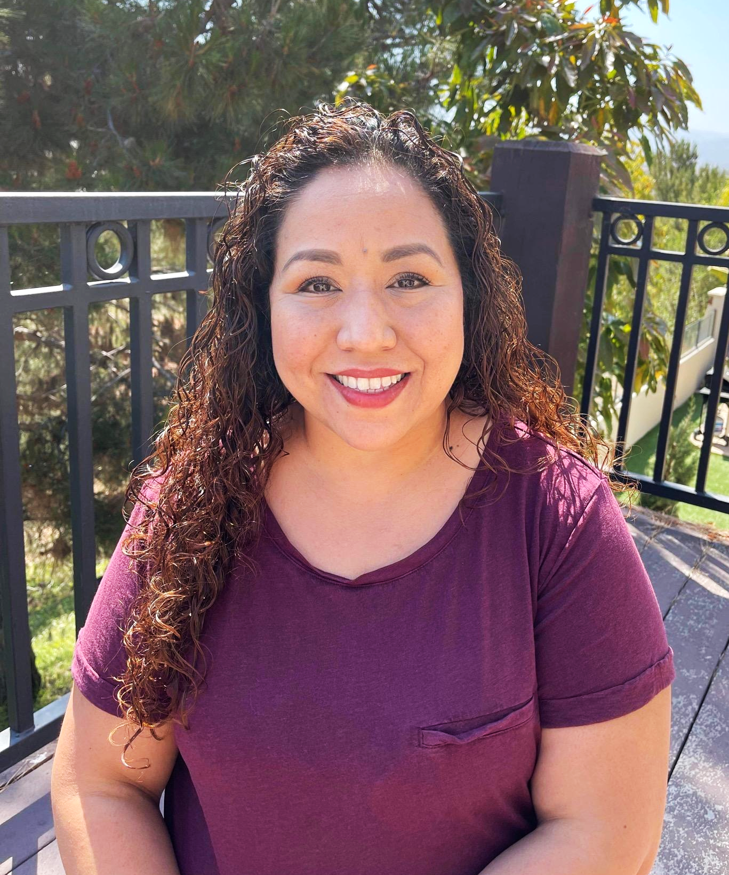
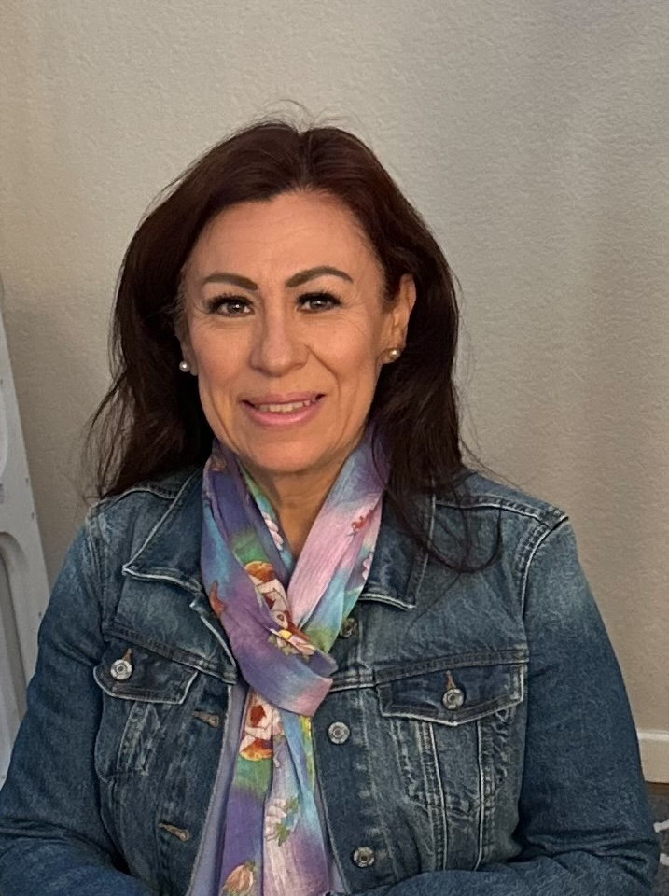
Sunny Trails Service Unit Managers
Your Meeting Host Tonight
Cindy Saenz DBJ@gssunnytrails.com | Julia Robles CSA@gssunnytrails.com

Slide 3
Meeting Agenda
Welcome
Announcements
Flag Ceremony
Service Unit News
Space Scientist Badge Workshop
YMCA Camp Surf
Live Scan
Michelle Mullen GSSD
Cathy Ejica / Caroline Montenegro
Volunteer Recognition
Volunteer Appreciation Dinner
Service Unit Open Positions
Council Events
Taste of Camp

Slide 4
Flag Ceremony
Girl Scout Promise/Law
Presented by Girl Scout Troop # 5169
On my honor, I will try: To serve God* and my country, To help people at all times, And to live by the Girl Scout Law.
I will do my best to be honest and fair, friendly and helpful, considerate and caring, courageous and strong, and responsible for what I say and do, and to respect myself and others, respect authority, use resources wisely, make the world a better place, and be a sister to every Girl Scout.

Slide 5
Seeking Troops for SU Meeting Flag Ceremony
We are looking for troops to come help us start our Service Unit Meetings. If you troop is interested in participating please reach out to Susanna King at CSA@gssunnytrails.com or DBJ@gssunnytrails.com to sign up.
Each Girl Scout who participates in the flag ceremony will earn this Sunny Trails Ceremony patch.

Slide 7
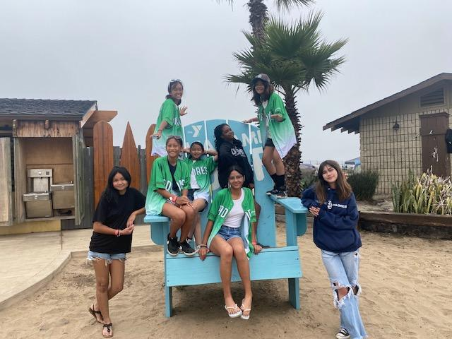
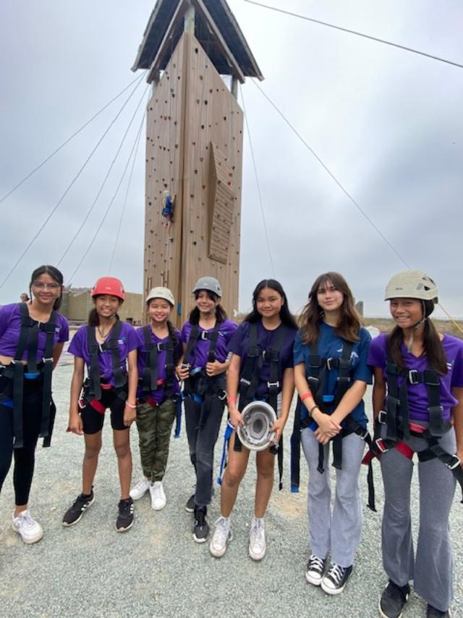
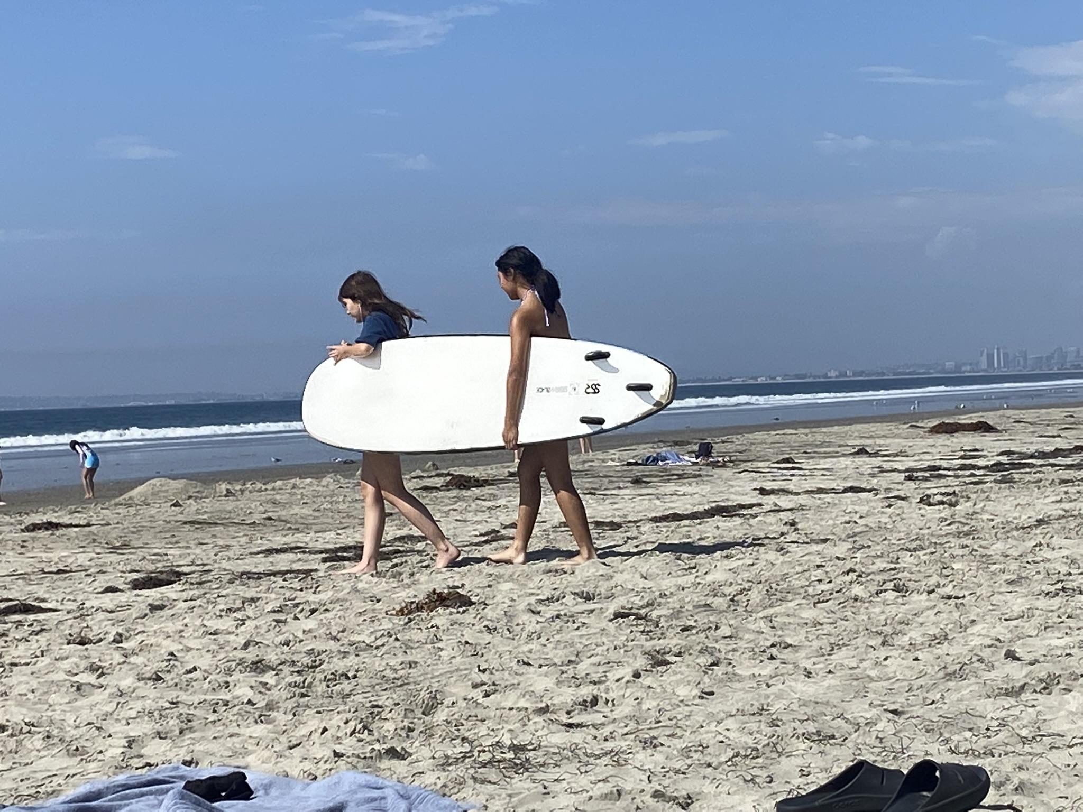

Slide 8
LiveScan - Don’t miss this opportunity!
Thank you to all have gone to get their LiveScan done!
If you need to get your LiveScan done, please send an email to customercare@sdgirlscouts.org with-
Subject: Fingerprinting- Sunny Trails
Message: I would like to sign up for fingerprinting.
Troop #:
Role:
and of course 2023/2024 Membership

Slide 9
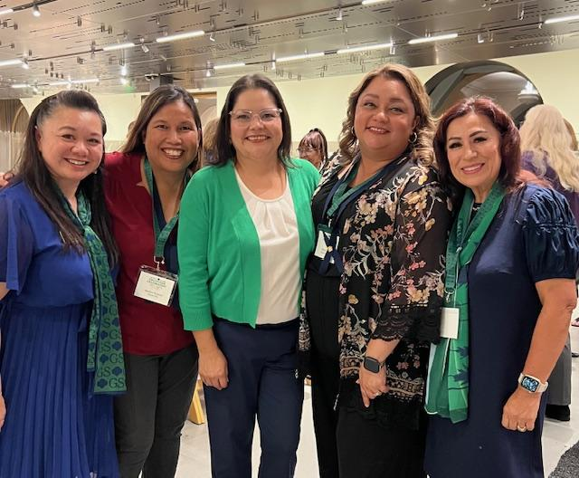
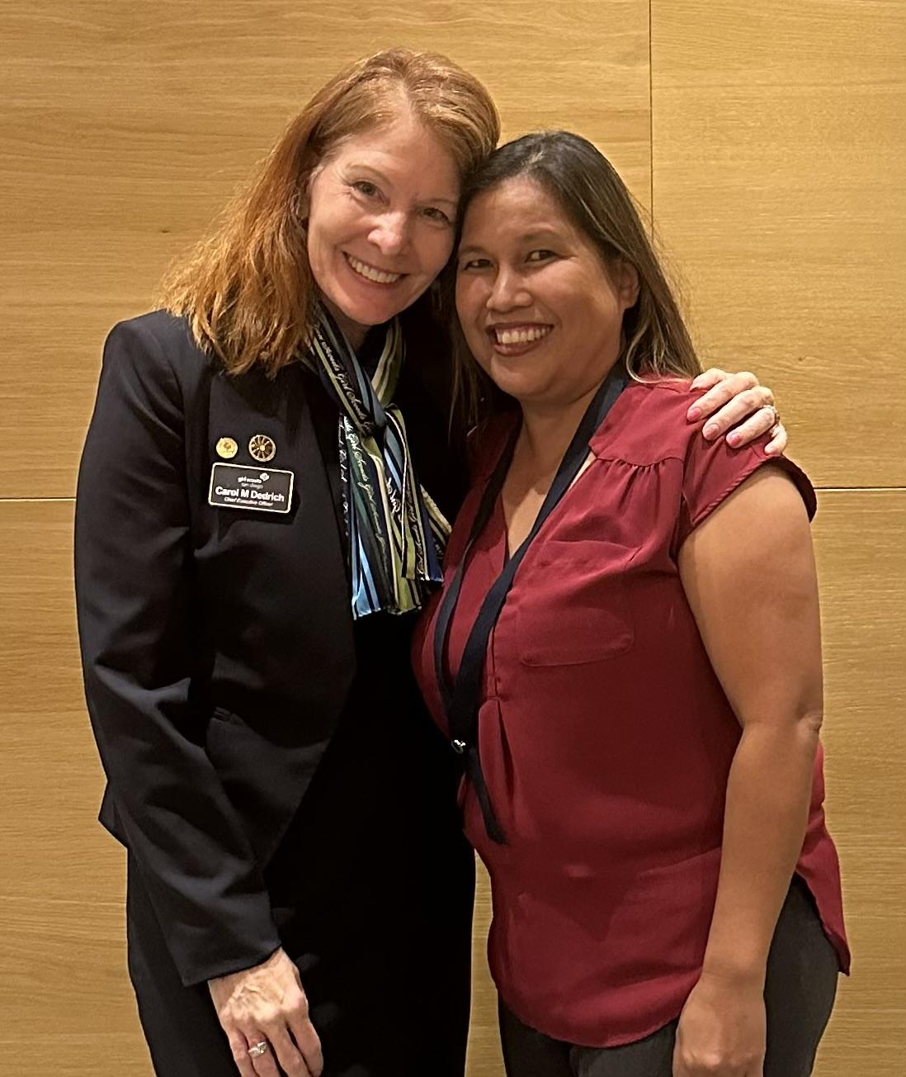
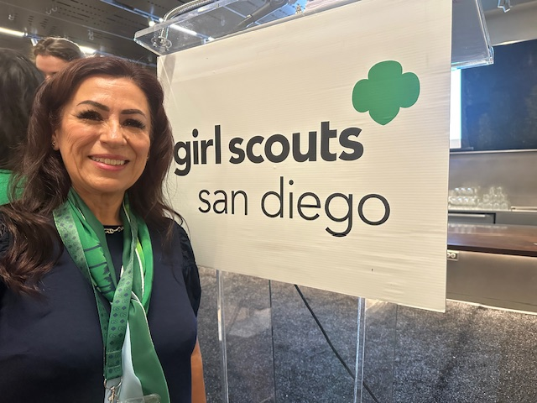
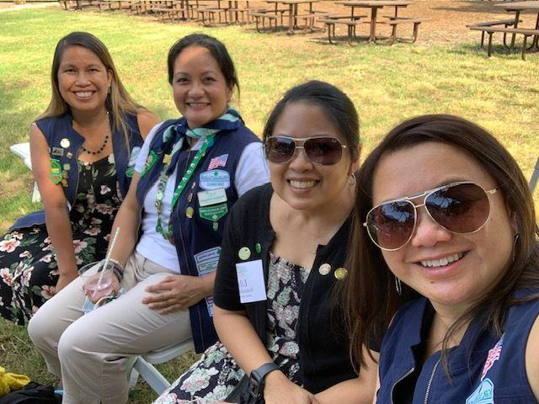
Volunteer Recognition
Nominations are now being accepted for 2024 Awards. Nominations and endorsements may be submitted online through Monday, June 3, 2024

Slide 10
Send an E-Card to a Rockstar Volunteer

Slide 11
Registration Closes on May 17 or until we reach capacity.
Volunteer Dinner is for all Leaders, Co-Leaders, Treasurers, Cookie Managers, Fall Managers and anyone else in the Troop you want to recognize and spend an evening out with.
You can use Troop money for this event.
Service Unit Level Awards include
Awards of Distinction
Years of Service

Slide 12
Thank you to our
Service Unit Team
2023-2024
Organizing Monthly Meetings, Planning Events, Encampments, Managing Fall Product Sales, Cookie Sales, Managing Chula Vista Cookie Cupboard, Raising Money for Share, Holding Recruitment Events.
Thank you!!! Thank you!!! Thank you!!!

Slide 13
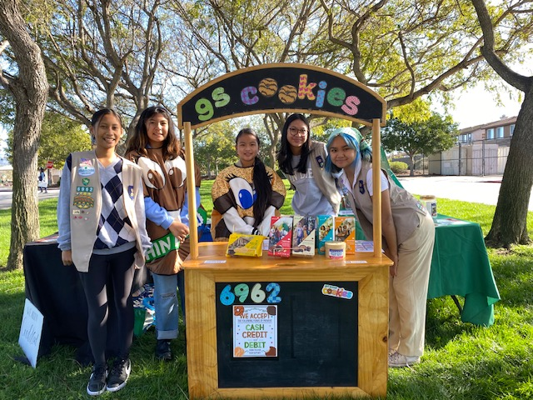
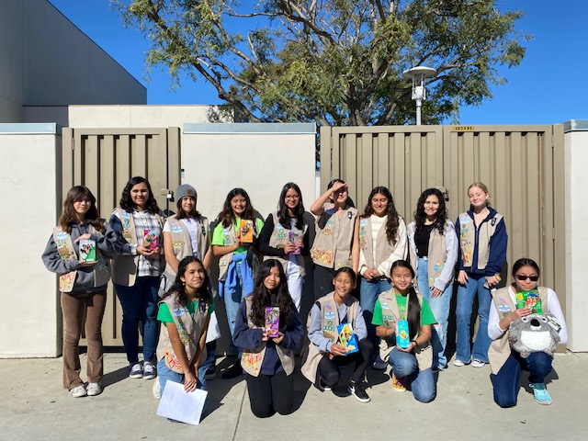
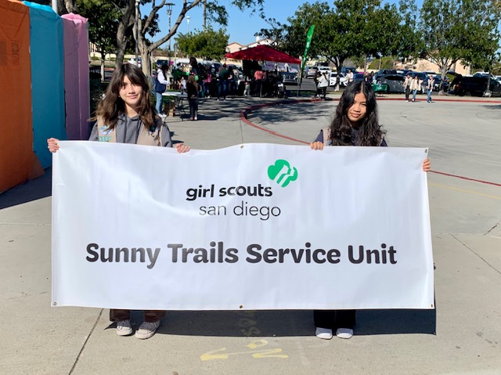
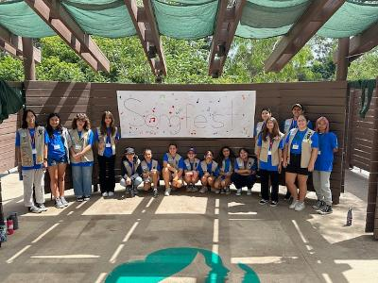
Thank you to our Volunteer Network
Songfest / Leadership Camp
Brownie Encampment
Cookie Kickoff
Planning of Mother Daughter Tea (TBA)
Planning of Recruitment Event (TBA)
We will recognize and celebrate at our
Leadership Camp in April.

Slide 14
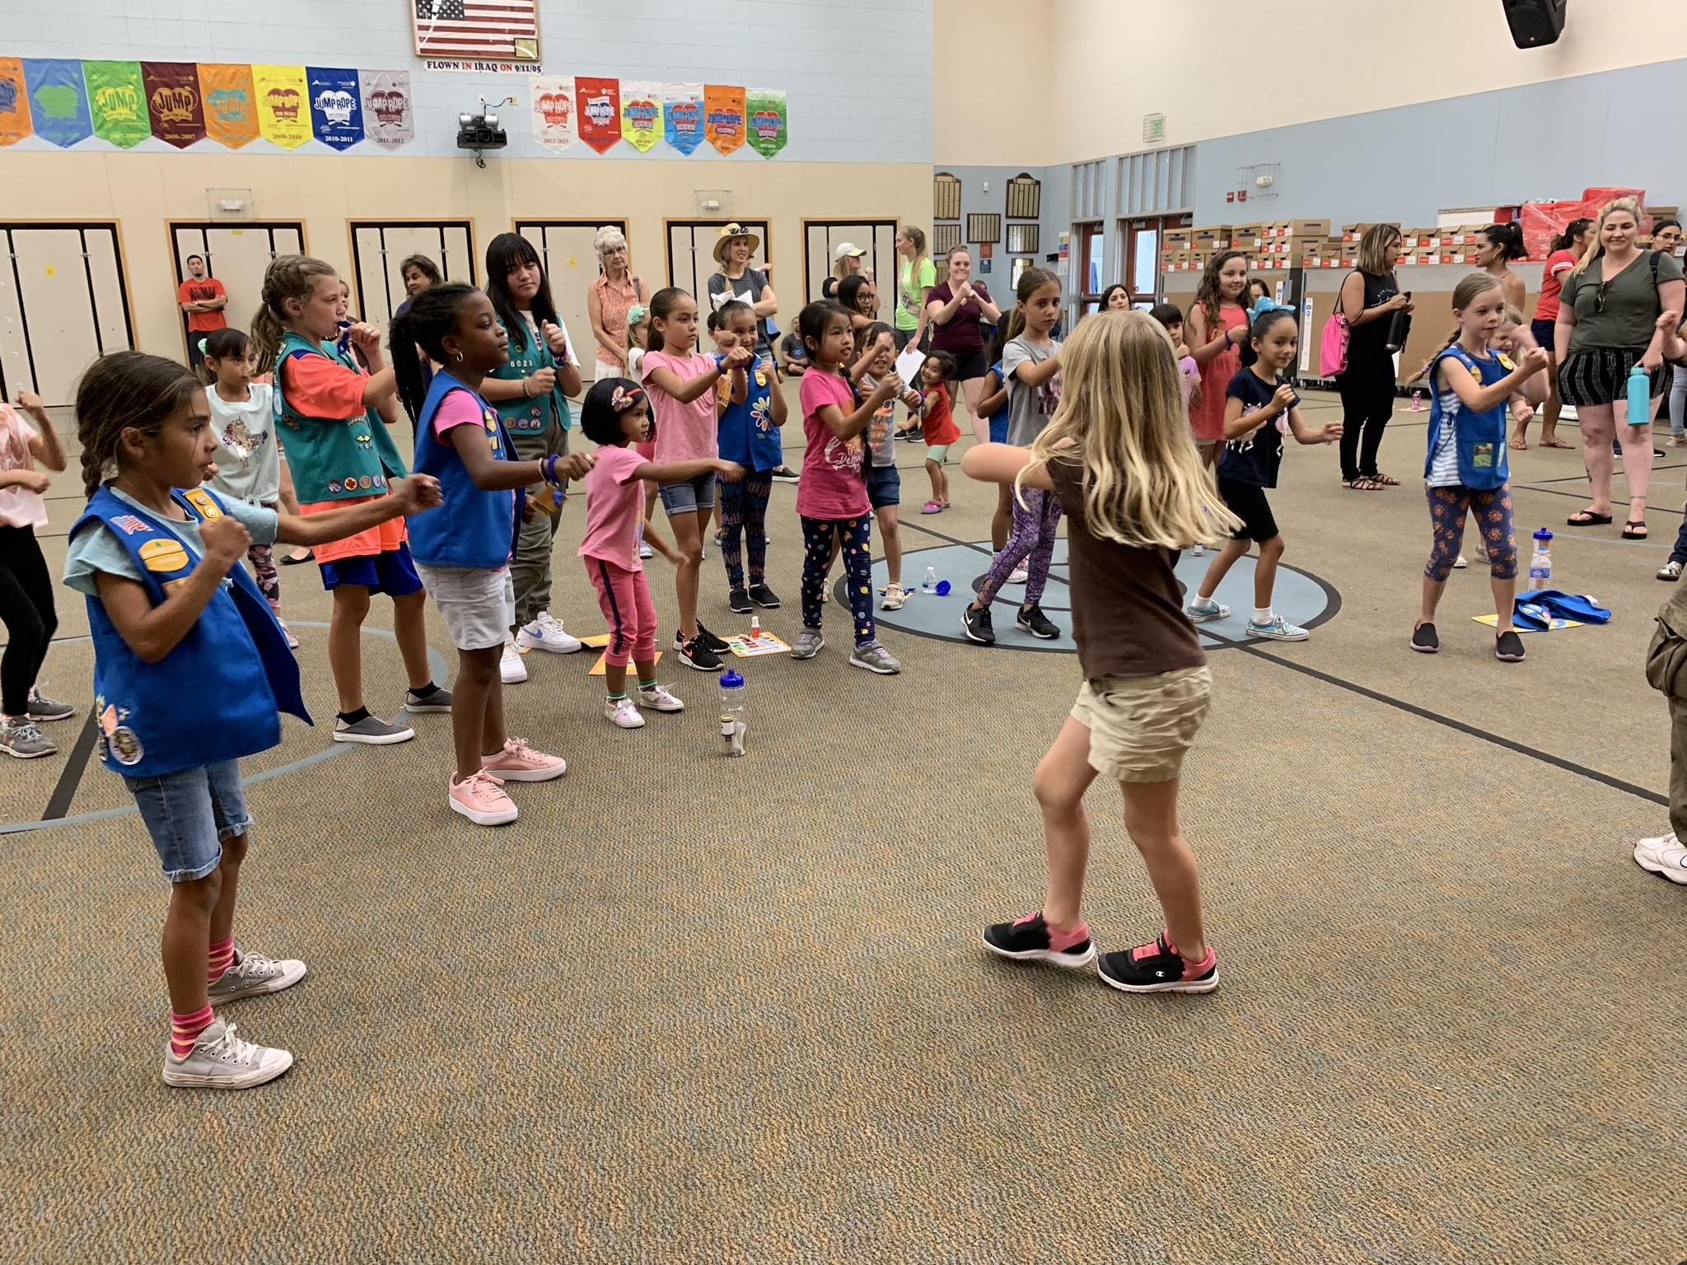
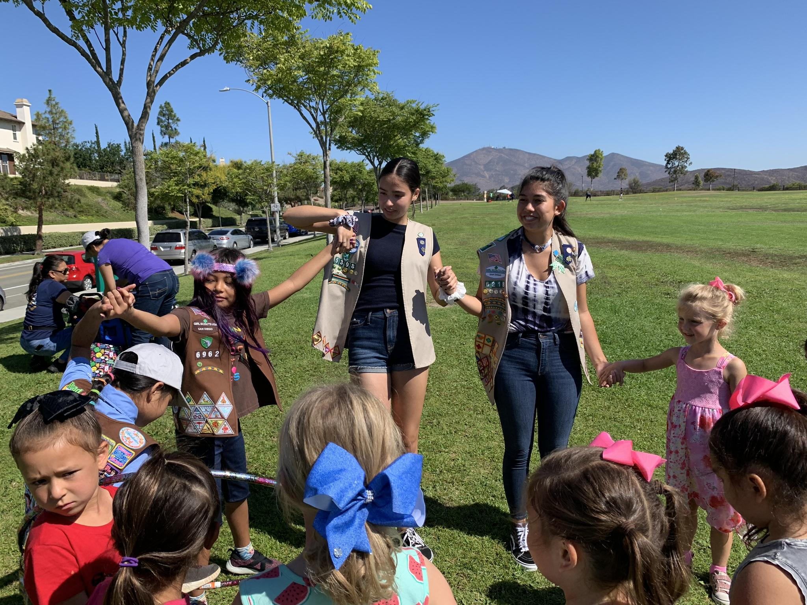
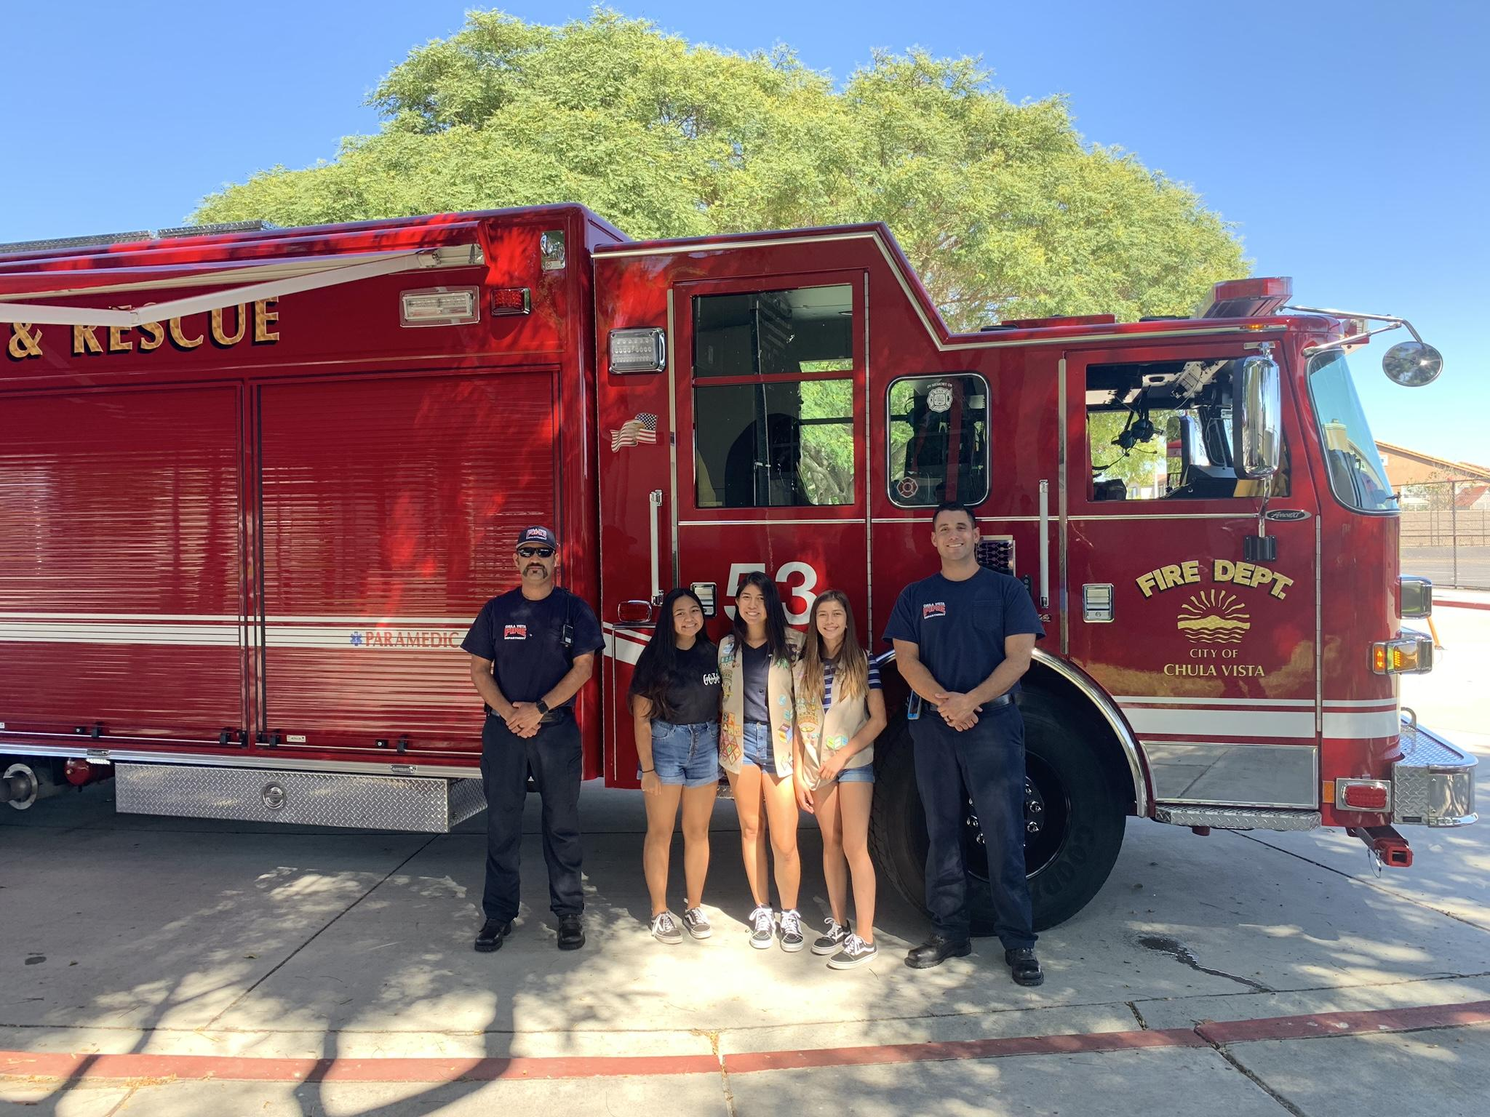
Open Positions
Recruitment/Registrar
Plan and Organize Recruitment Events
Help place girls that are looking to join Girl Scouts
Support Service Unit through Girl Scout Registration

Slide 15
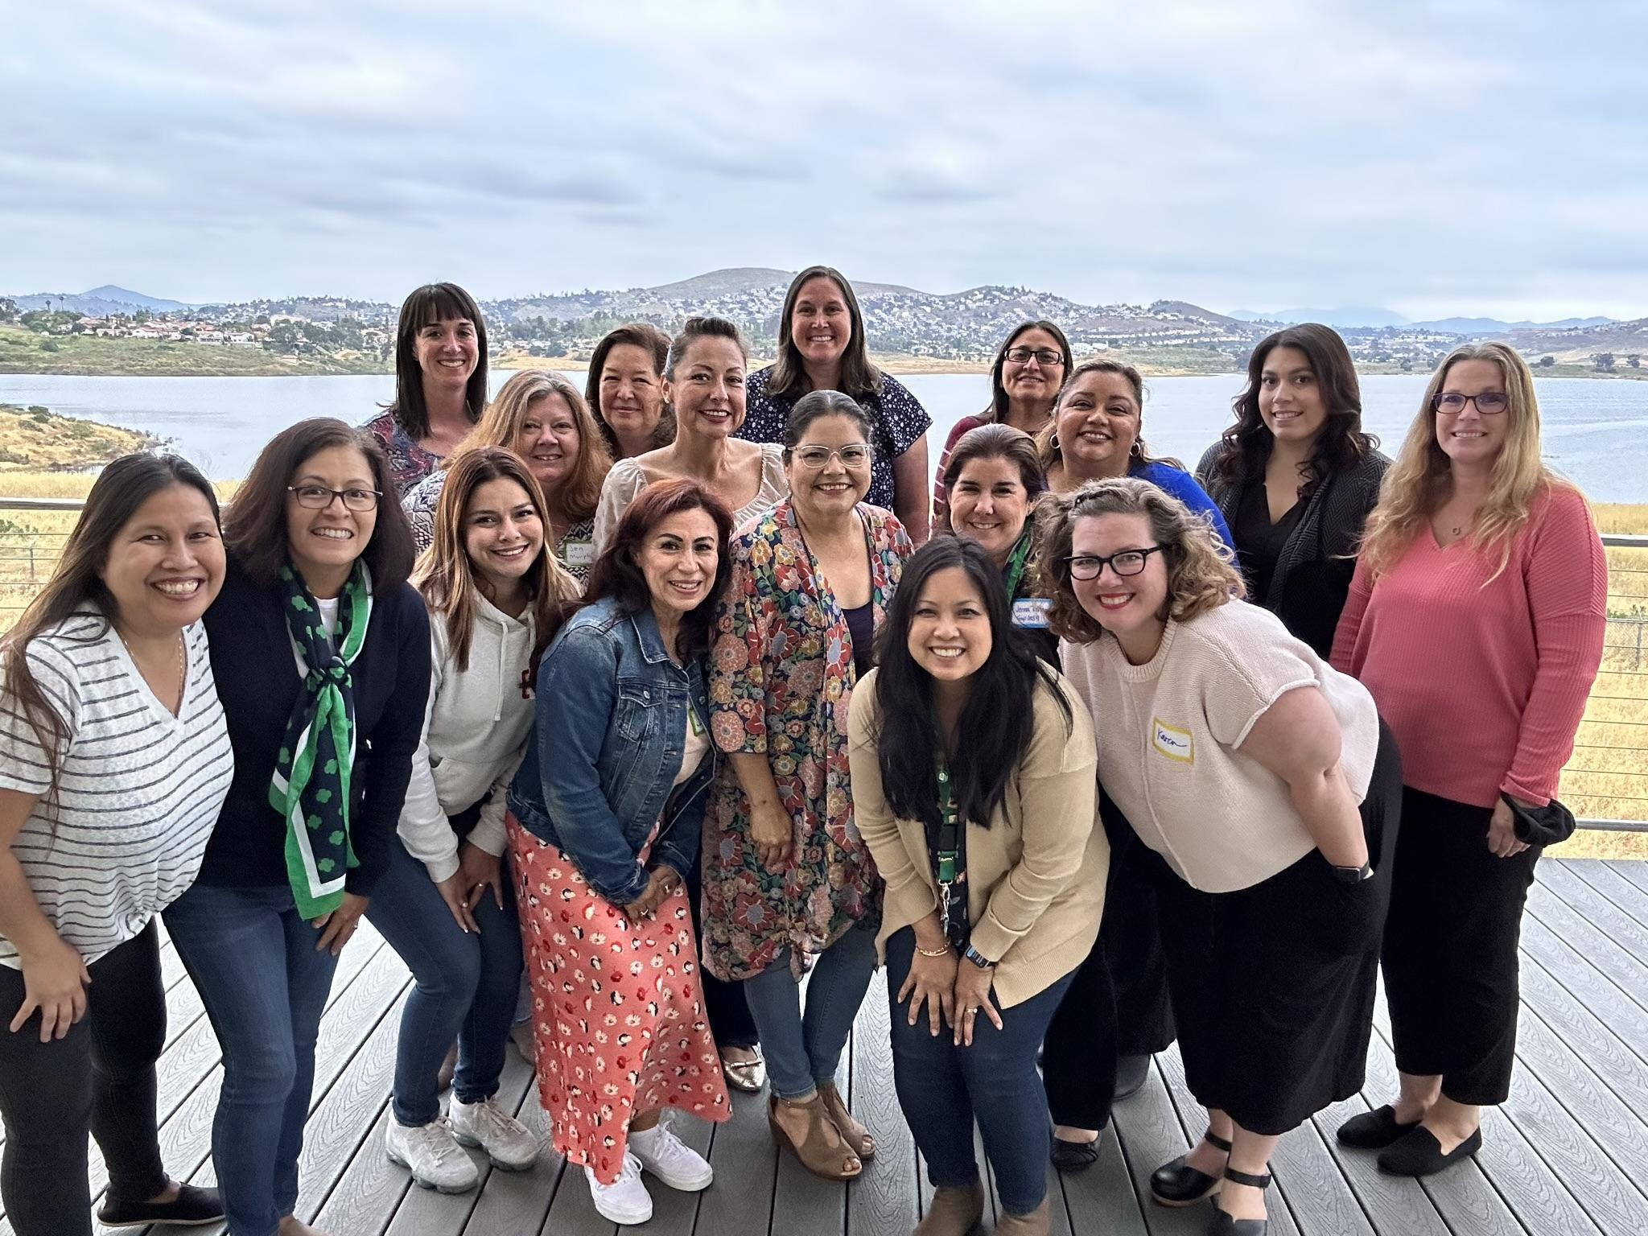
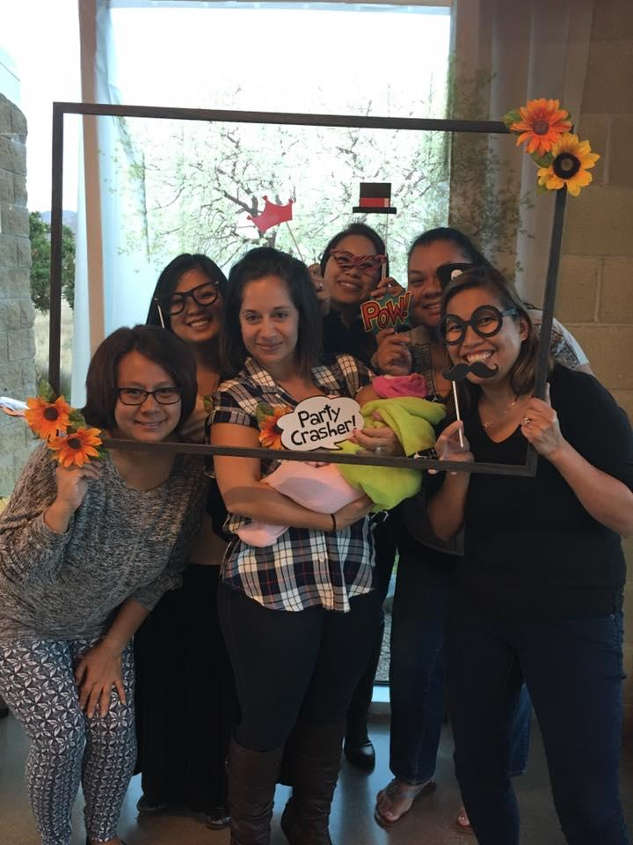
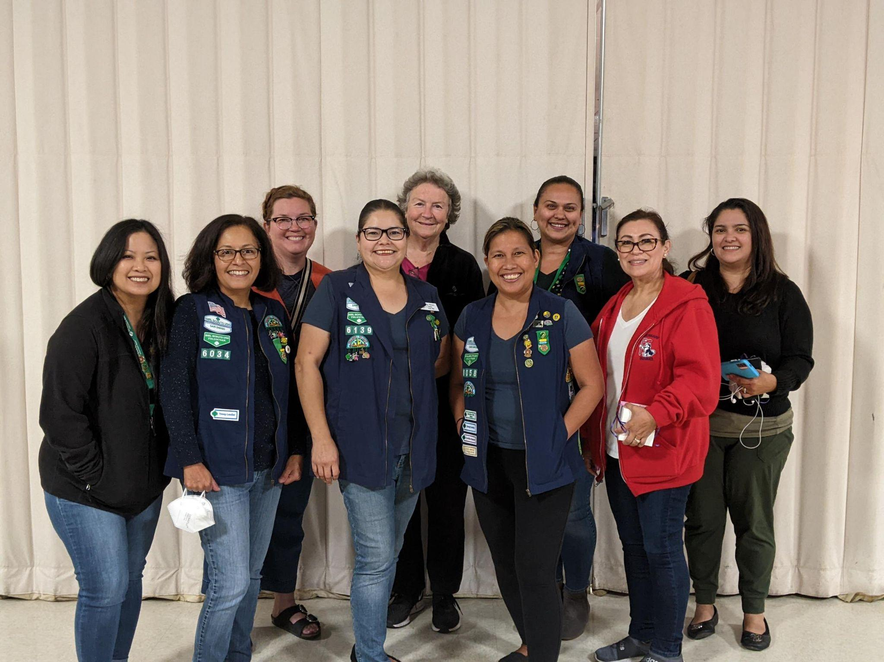
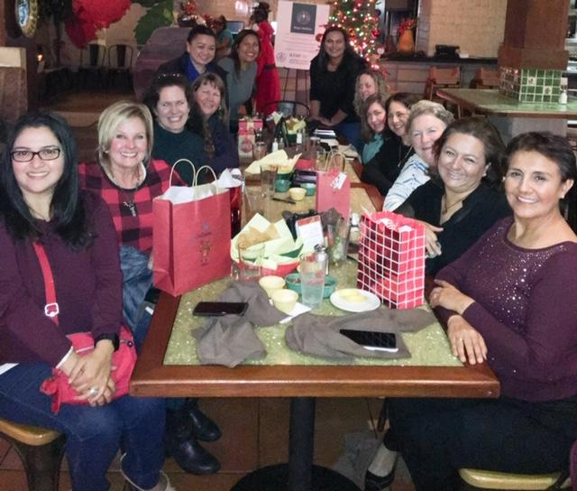
Open Positions
Recognitions
Plan Recognition Events to Support the Service Unit

Slide 16
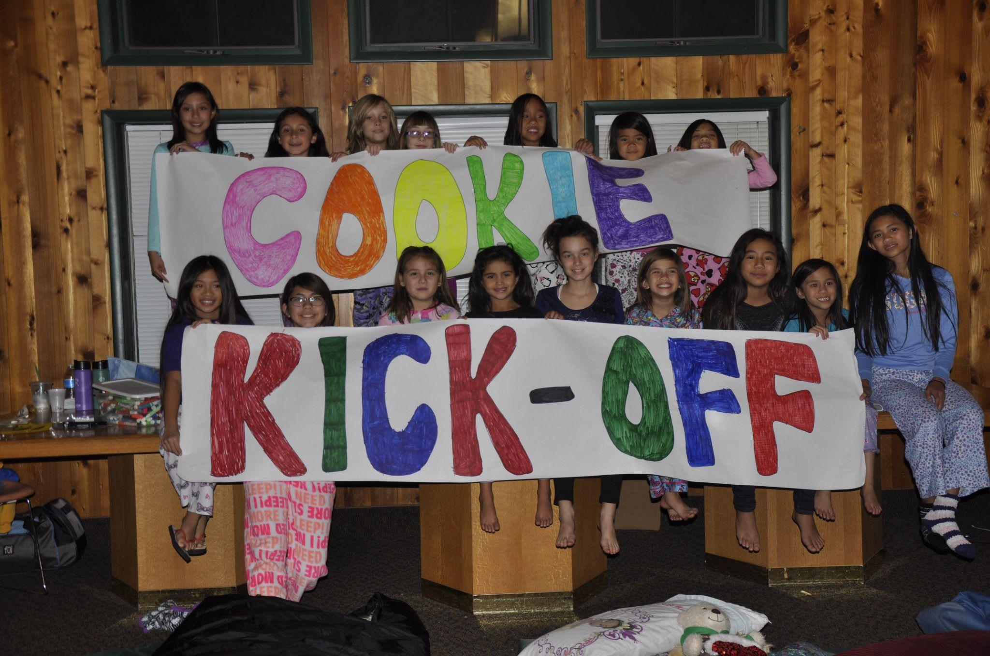
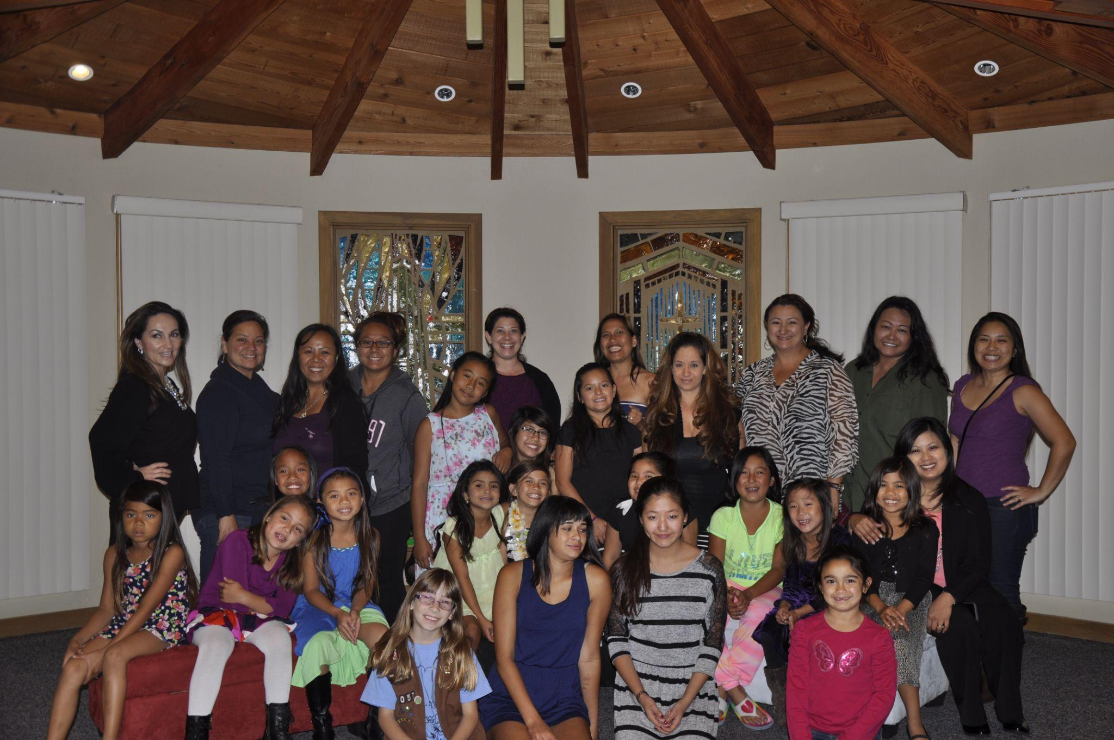
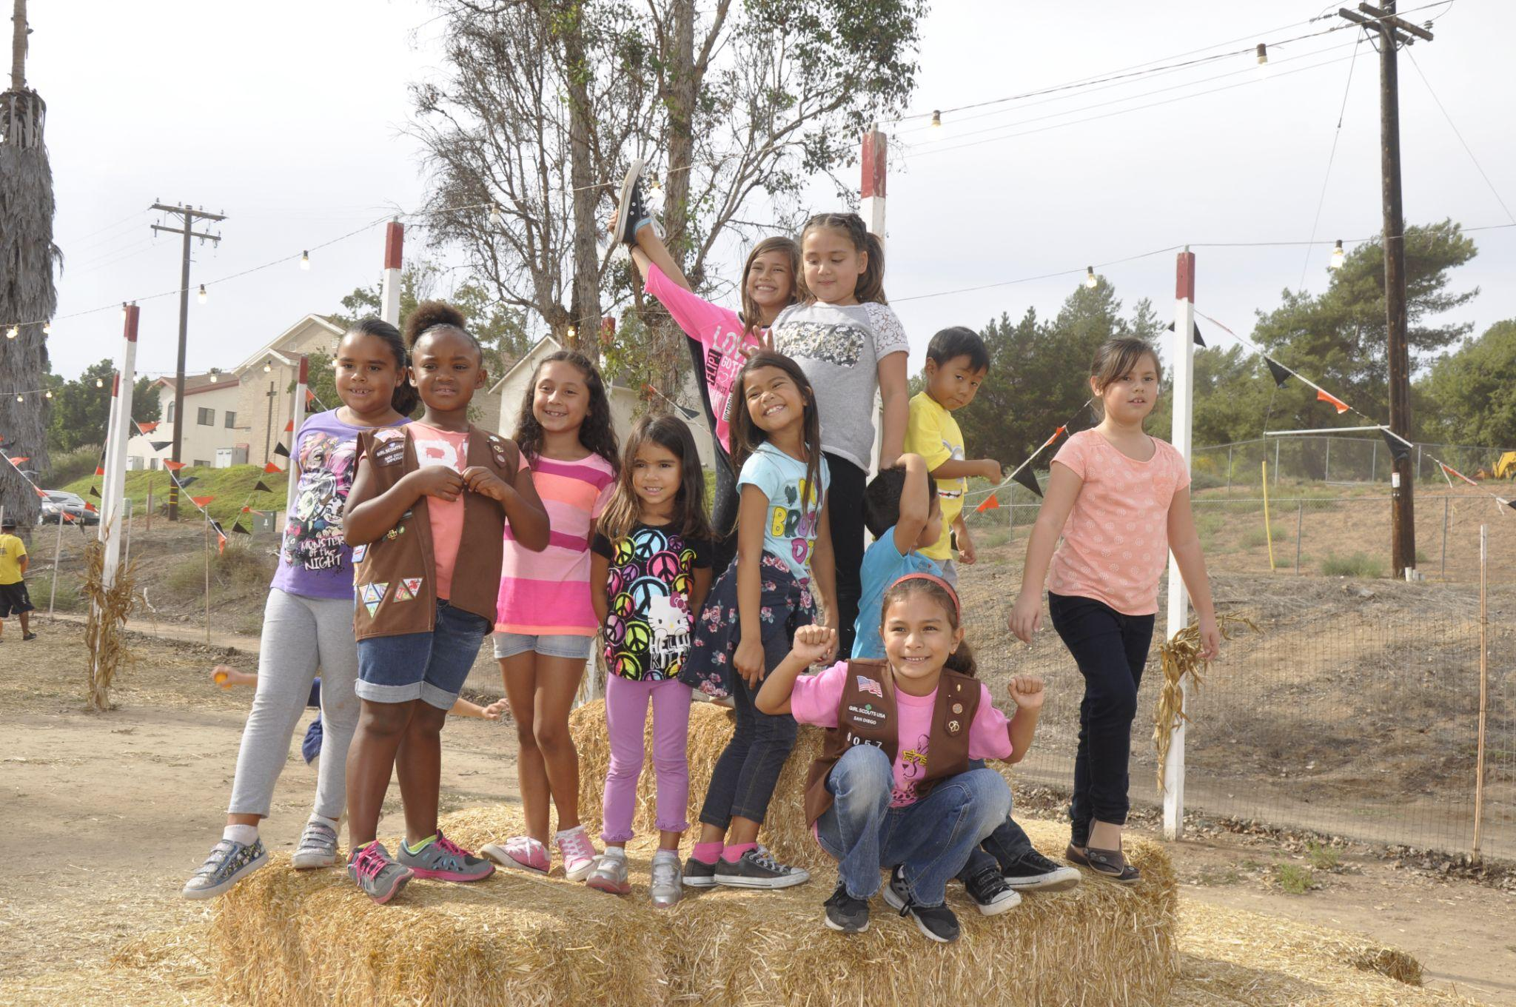
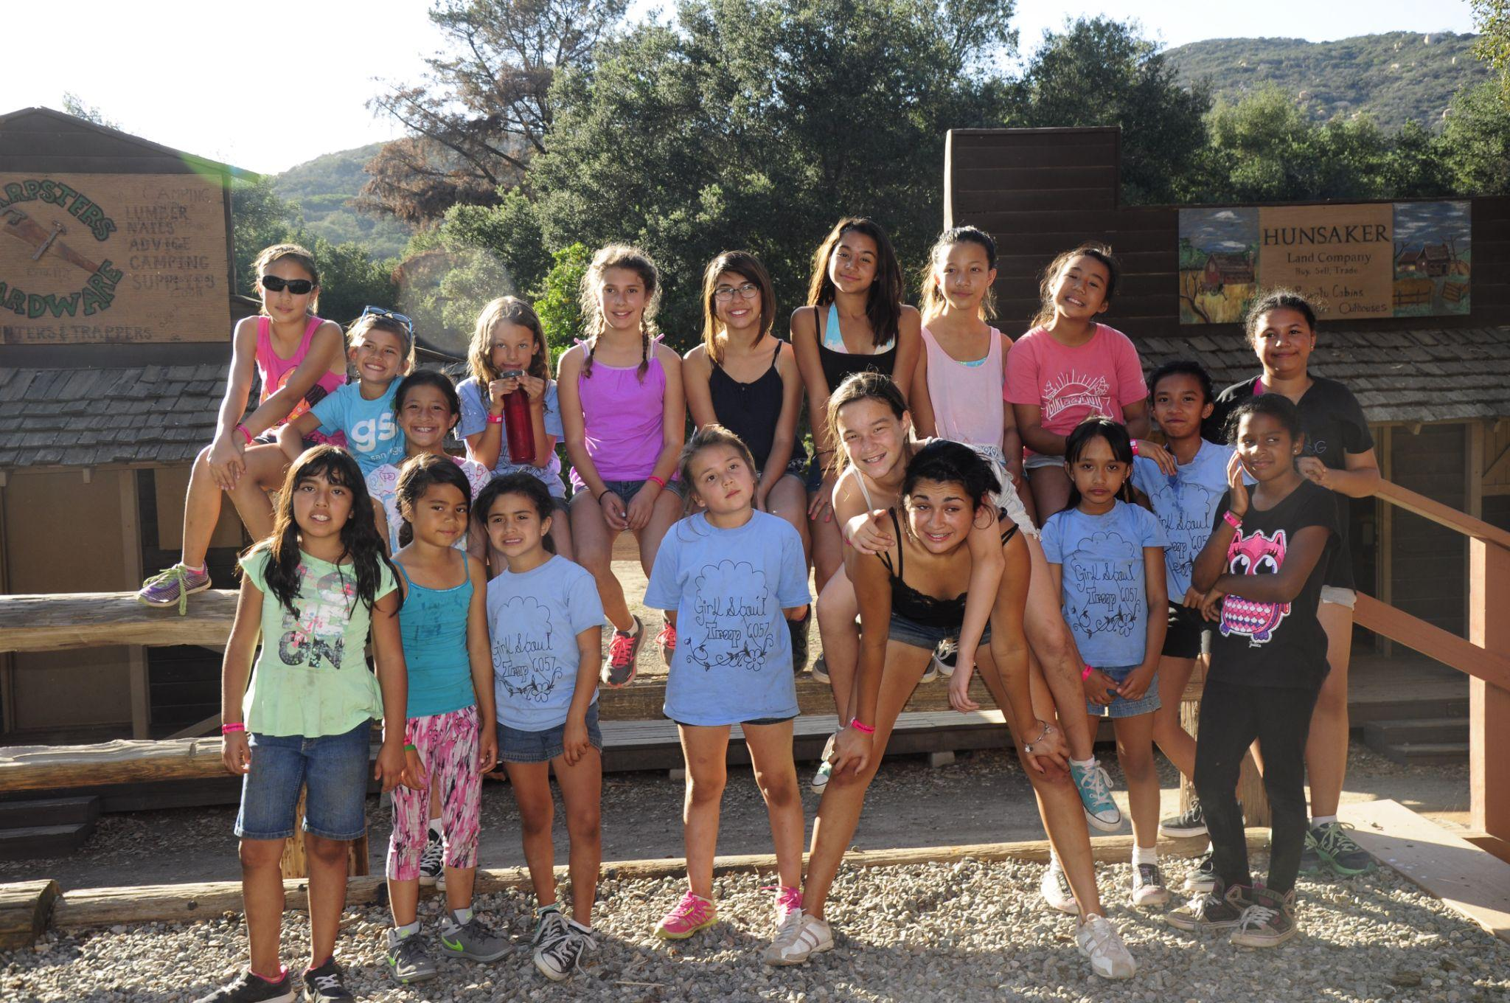
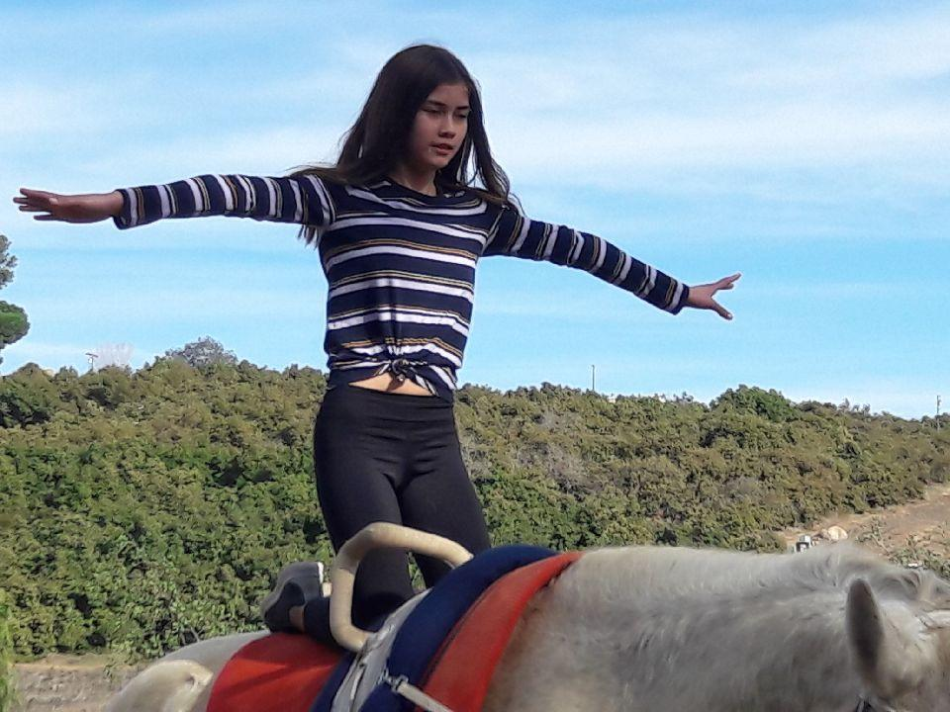
Open Position
Treasurer (Shadow)
Track Troop Finances
Teach other Treasurer how to manage their troop finances and file their reports
Support Service Unit Where needed

Slide 17
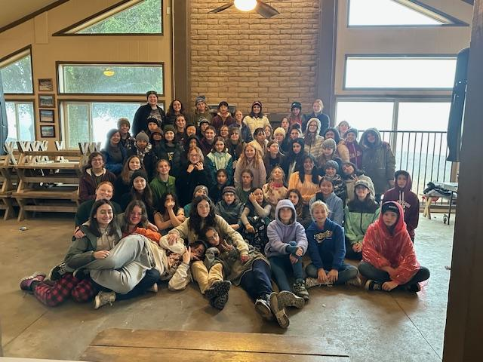
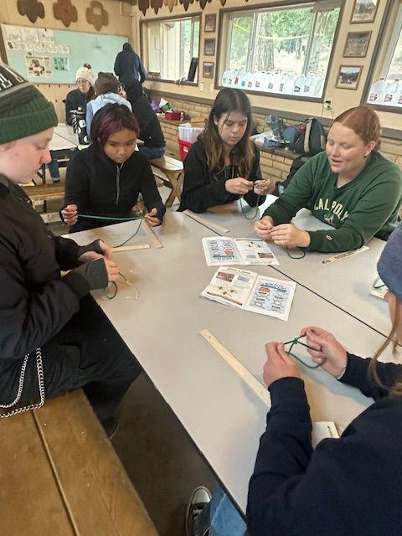
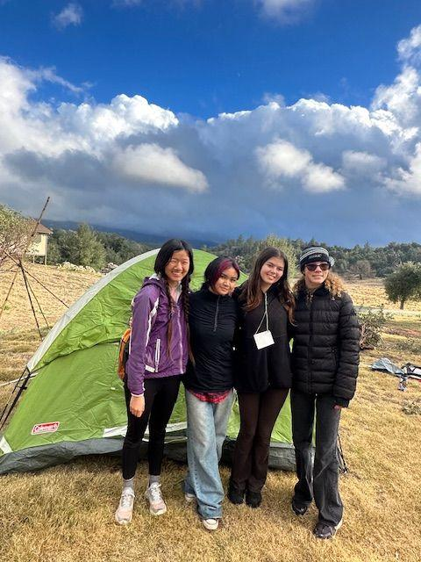
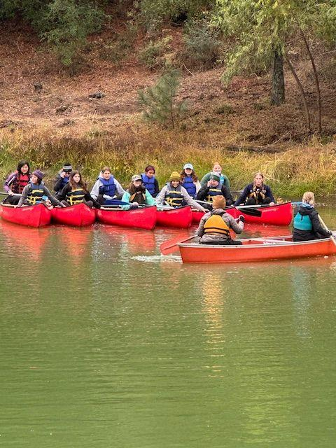
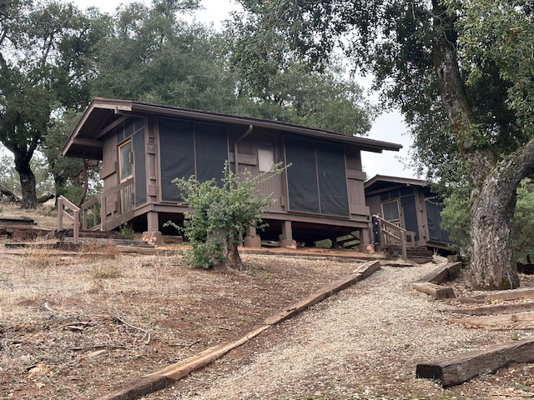
Open Positions
Encampment (Shadow)
Plan and organize encampments for Sunny Trails (Usually 1 Encampment per year)

Slide 18
Thank You for Joining Us!
Sunny Trails Service Unit Team
Service Unit Manager Daisy, Brownie, Junior Troops | Cindy Saenz | DBJ@gssunnytrails.com
Service Unit Manager Cadette, Senior, Ambassador Troops | Julia Robles | CSA@gssunnytrails.com
New Troops Support | Dolly Purificacion | newtroops@gssunnytrails.com
Treasurer and Troop Financials | Marilou Thomas | treasurer@gssunnytrails.com
Registrar/Recruitment | Amber Vissuet | registrar@gssunnytrails.com
Product Sales Committee Chair | Julia Robles | cookies@gssunnytrails.com
Product Sales Nuts | Karen Pickens | nuts@gssunnytrails.com
Recognitions | OPEN | recognitions@gssunnytrails.com
Activity Consultant | Caroline Montenegro | cmontenegro@sdgirlscouts.org
Encampment Director | Marisa Segoviano | encampment@gssunnytrails.com
Sunny Trails Website | Debbie Lechner | website@gssunnytrails.com
SHARE Coordinator | Selena Ellis-Vizcarra | share@gssunnytrails.com

Slide 19
Please join us at our next meeting on Thursday, May 16th 2024. Our next meeting will be a in-person Meeting Starting at 7 p.m.
Sunny Trails

